Slide 1
Great River Energy
2015 Attachment O
Annual Projected Rate Meeting
October 31, 2014

Slide 2
Agenda
Introduction
Disclosure
Meeting purpose
Great River Energy corporate profile
Attachment O calculation
Capital projects
Budget risks
Information exchange procedures
Question/answer

Slide 3
Disclosure
All figures in this document are preliminary and subject to change. Per the revised Formula Rate Protocols, figures will be finalized after the Information Exchange, Challenge Procedures, and MISO’s review are complete¹.
¹ Awaiting FERC’s final decision on Docket ER13-2379 on FERC’s investigation into MISO Formula Rate Protocols
Notes:
Make notes to discuss the status of ER13-2379

Slide 4
Meeting purpose
FERC requires GRE to hold an annual projected rate meeting by October 31 each year to (i) permit GRE to explain and clarify it’s projected net revenue requirement and (ii) provide interested parties an opportunity to seek information and clarifications from GRE about the projected net revenue requirement
Great River Energy’s projected net revenue requirement and associated network rate commencing January 1, 2015 is calculated using GRE’s Attachment O formula rate template within the MISO tariff

Slide 5
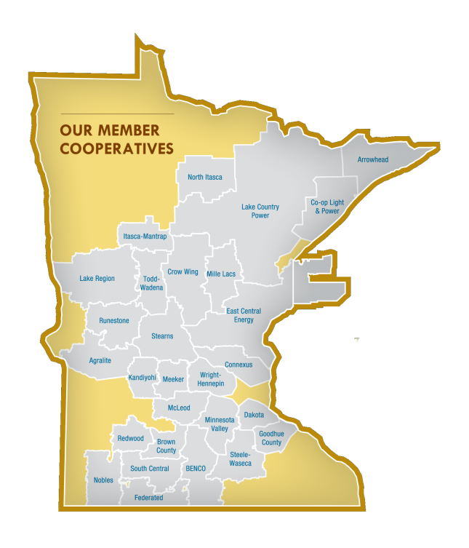
Corporate profile
28 member cooperatives
– 650,000 member-consumers
4th largest Generation & Transmission cooperative in the nation
  $3.7 billion assets
  $2.8 billion debt
  $980 million revenue
880 employees (MN and ND)
3,619 MW generation
  701 MW renewables
4,660 miles transmission
102 transmission substations

Slide 6
Attachment O
Forward rate requirements
GRE revenue requirement distribution
Rate base
Operating expenses
Rate of return
Revenue requirement
Network rate summary

Slide 7
Forward rate requirements
By June 1 of each year GRE will post on OASIS all information in regards to our Attachment O, Attachment MM, and Schedule 1 True-Up Adjustment for the prior year including the associated workpapers and supplemental notes
By August 1 of each year GRE will post on OASIS all information in regards to our Attachment GG True-up Adjustment for the prior year
By September 1 of each year GRE will post on OASIS our projected Attachment O, Attachment GG, Attachment MM, and Schedule 1 including the True-Up Adjustments, associated work papers, and supplemental notes
By October 31 of each year, GRE will hold an Annual Projected Rate Meeting to permit GRE to explain and clarify our projected net revenue requirement

Slide 8
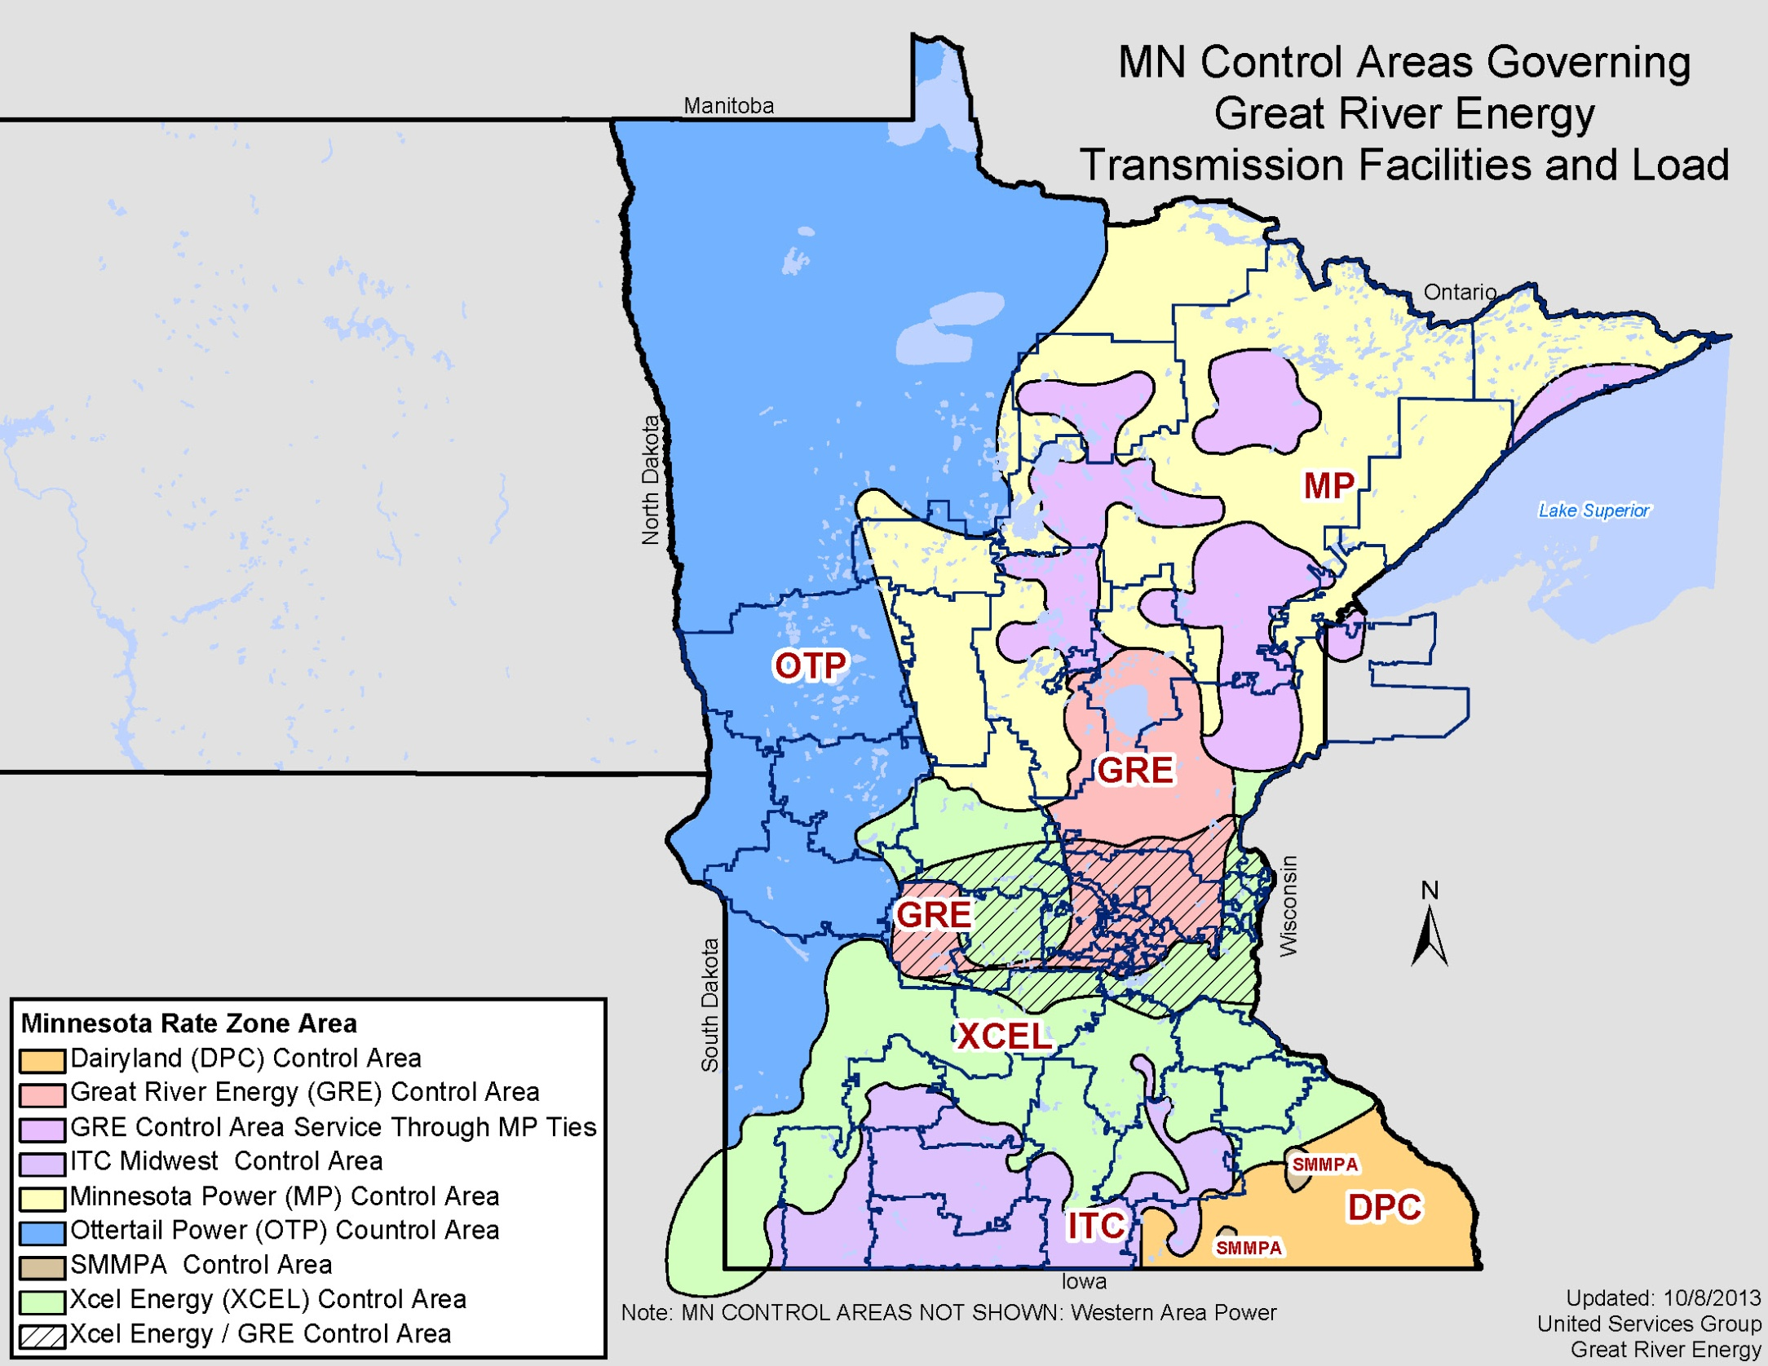

Slide 9
GRE revenue requirement distribution
GRE NET ATRR
GRE PRICING ZONE
OTP PRICING ZONE
NSP PRICING ZONE
ITCM PRICING ZONE
MP PRICING ZONE
  Per Schedules 7,8, & 9 of the MISO Tariff, each Transmission Owner's total revenue requirement is allocated proportionately to each Zone in which the Transmission Owner owns transmission facilities based on the gross plant value of its facilities located in that Zone relative to the gross plant value of its facilities in all Zones, as reflected in Attachment O
* Per Docket ER10-187, the gross plant value to use is transmission gross plant less the gross plant value of transmission facilities associated with Attachment GG and MM.

Slide 10
Rate base
Rate Base Item | 2014 Projected Amount | 2015 Projected Amount | $ Change | % Change | Explanation
Gross Plant In Service | $ 960,431,604 | $ 1,077,306,524 | $ 116,874,920 | 12.17% | Remainder of Brookings and Fargo CapX projects going into service
Accumulated Depreciation | $ 322,572,983 | $ 310,138,514 | $ (12,434,469) | -3.85%
Net Plant In Service | $ 637,858,622 | $ 767,168,010 | $ 129,309,388 | 20.27% | Remainder of Brookings and Fargo CapX projects going into service
100% CWIP Recovery for Incentive Rate Transmission Projects | $ 101,165,538 | $ 40,815,524 | $ (60,350,014) | -59.65% | Remainder of Brookings and Fargo CapX projects going into service
Adjustments To Rate Base | $ (13,256,507) | $ (18,023,811) | $ (4,767,304) | 35.96% | AFUDC offset increasing due to remainder of CapX projects going into service
Land Held For Future Use | 0 | 0 | 0 | 0
Working Capital | $ 29,996,231 | $ 28,950,392 | $ (1,045,839) | -3.49%
Rate Base | $ 755,763,883 | $ 818,910,115 | $ 63,146,231 | 8.36% | = Net Plant + CWIP + Adjustments + LHFFU + Working Capital

Slide 11
Operating expenses
Expense Item | 2014 Projected Amount | 2015 Projected Amount | $ Change | % Change | Explanation
O&M | $ 38,190,787 | $ 46,592,008 | $ 8,401,221 | 22.00% | Increasing O&M costs associated with: regulatory compliance activities (NERC), CapX capital additions, vegetation management expense
A&G | $ 10,973,064 | $ 11,301,656 | $ 328,592 | 2.99%
Depreciation Expense | $ 25,901,568 | $ 26,070,575 | $ 169,008 | 0.65% | Increasing due to remainder of CapX projects going into service
Taxes Other Than Income Taxes | $ 2,226,382 | $ 2,240,317 | $ 13,935 | 0.63%
Income Taxes | $ - | $ - | $ - | 0.00% | GRE doesn't pay income taxes
Operating Expenses | $ 77,291,800 | $ 86,204,556 | $ 8,912,756 | 11.53% | = O&M + A&G + Depreciation + Taxes

Slide 12
Rate of return
 | 2014 Projected Amount | 2015 Projected Amount | Change | % Change | Explanation
Long Term Debt | 86.60% | 83.82% | -2.78% | -3.21%
Proprietary Capital | 13.40% | 16.18% | 2.78% | 20.75% | GRE is working on a corporate strategy to raise our equity to 20% by 2020
Total | 100% | 100% |  |  | = Debt + Equity
Weighted Cost of Long Term Debt | 4.52% | 4.70% | 0.18% | 3.99%
Weighted Cost of Proprietary Capital | 1.66% | 2.00% | 0.34% | 20.75%
Rate of Return | 6.18% | 6.70% | 0.52% | 8.49% | = (LT Debt * Cost) + (Equity * Cost)

Slide 13
Revenue requirement
 | 2014 Projected Amount | 2015 Projected Amount | $ Change | % Change | Explanation
Rate Base | $ 755,763,883 | $ 818,910,115 | $ 63,146,231 | 8.36% | From "Rate Base" Calculation
Return | $ 46,689,363 | $ 54,885,110 | $ 8,195,747 | 17.55% | = Rate of Return * Rate Base
Operating Expenses | $ 77,291,800 | $ 86,204,556 | $ 8,912,756 | 11.53% | From "Operating Expense" Calculation
Attachment GG Adjustment | $ (22,556,884) | $ (31,752,332) | $ (9,195,448) | 40.77% | Attachment GG Revenue Requirement
Attachment MM Adjustment | $ (9,983,045) | $ (14,079,982) | $ (4,096,937) | 41.04% | Attachment MM Revenue Requirement
Gross Revenue Requirement | $ 91,441,234 | $ 95,257,351 | $ 3,816,117 | 4.17% | = Return + Operating Expenses - Adjustments
Revenue Credits | $ (4,005,472) | $ (3,304,621) | $ 700,851 | -17.50%
Revenue Requirement w/o True-Up | $ 87,435,762 | $ 91,952,730 | $ 4,516,968 | 5.17%
Attachment O True-Up | $ 2,807,652 | $ 2,851,351 | $ 43,699 | 1.56% | 2013 True-Up included in 2015 rate may change pending MISO's review.
Net Revenue Requirement | $ 90,243,415 | $ 94,804,082 | $ 4,560,667 | 5.05% | = Gross Rev Req - Rev Credits + True-Up

Slide 14
Network rate summary
$/kW/Mo

Slide 15
2015 GRE revenue requirement distribution
GRE NET ATRR $94,804,082
100%
GRE PRICING ZONE $52,005,900
54.9%
OTP PRICING ZONE $5,347,144
5.6%
NSP PRICING ZONE $25,301,984
26.7%
ITCM PRICING ZONE $2,920,963
3.1%
MP PRICING ZONE $9,228,091
9.7%
Attachment O
Attachment GG $31,300,043
Attachment MM
$13,824,476
Total Attachment O, GG and MM Revenue Requirement = $139,928,601*
*Inclusive of 2013 True-Up Amounts

Slide 16
2015 Capital additions
Attachment O $31.5M
Attachment GG $117.4M
Attachment MM $49.5M
+
+
=
$198.4M
Attachment O facilities do not include “excluded facilities” per page 4 of Attachment O
GRE PRICING ZONE
MP PRICING ZONE
NSP PRICING ZONE
OTP PRICING ZONE
ITCM PRICING ZONE
$17.7M
$0.8M
$10.4M
$2.3M
$0.3M

Slide 17
2015 Capital additions
Attachment “O” projects > $100K

Slide 18
2015 Capital additions
Attachment “GG” projects

Slide 19
2015 Capital additions
Attachment “MM” projects

Slide 20
Budget risks
  Revenue
  Demand/weather
  Regulatory filings
  Financing
  Outages
  Timing of capital projects
  Tight budgets

Slide 21
Information exchange procedures
Interested parties can submit information requests until December 1, 2014
GRE will make a good faith effort to respond within 15 business days of receipt of such requests
Any information request must be submitted in writing to tbutkowski@GREnergy.com
GRE will post on the MISO website and OASIS all information requests from interested parties and GRE’s responses

Slide 22
Questions?
Additional questions may be submitted in writing to
Todd Butkowski
tbutkowski@GREnergy.com or
Seth Nelson
snelson@GREnergy.com

