Slide 1
Project Status Update
TFR Meeting
June 26, 2012

Slide 2
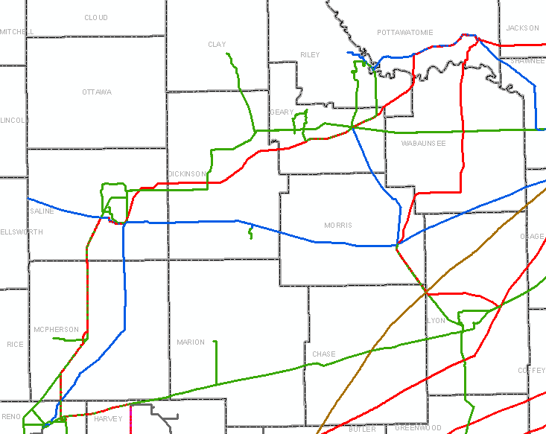
Northwest

Slide 3
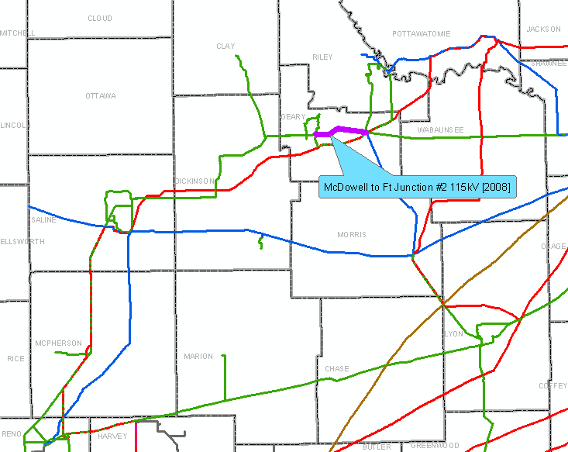

Slide 4
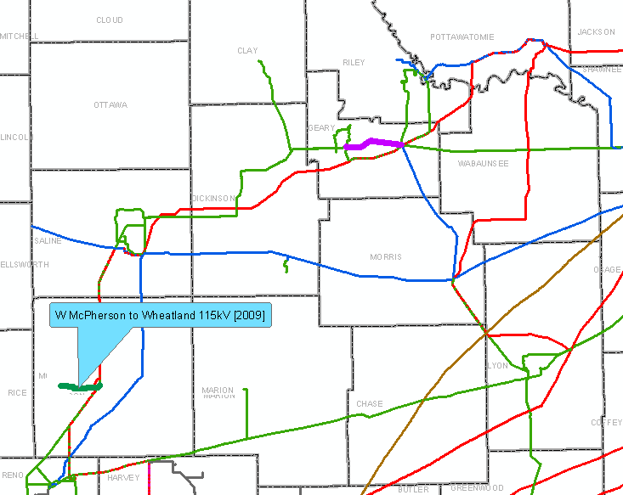

Slide 5
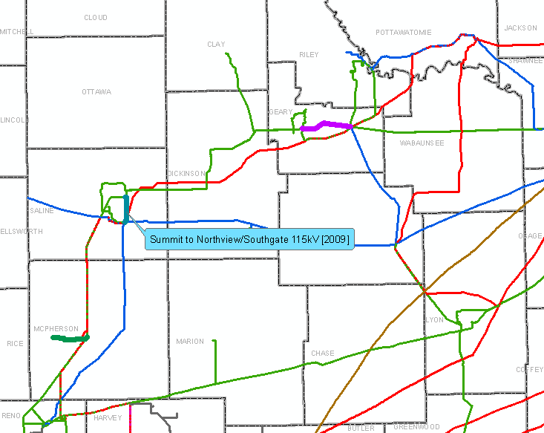

Slide 6
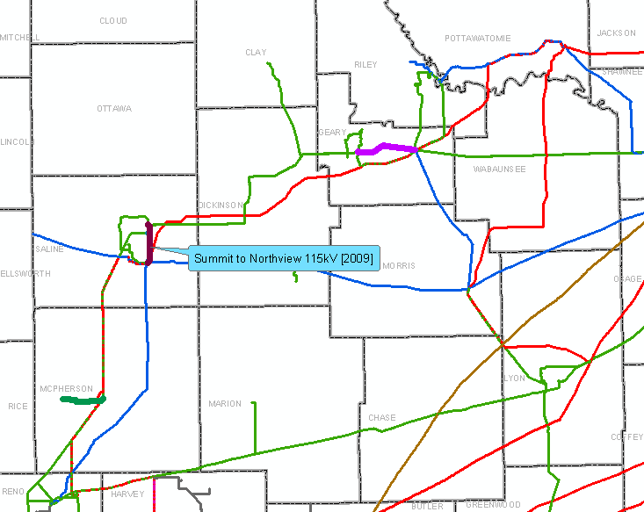

Slide 7
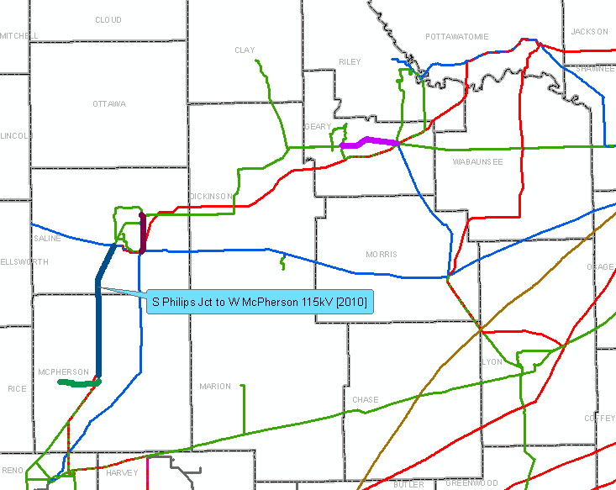

Slide 8
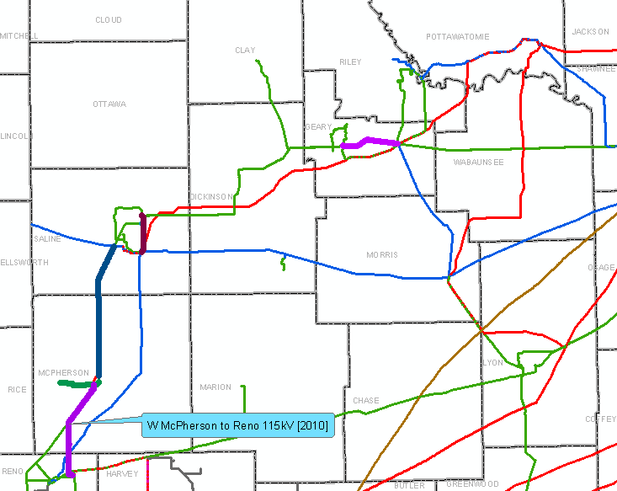

Slide 9
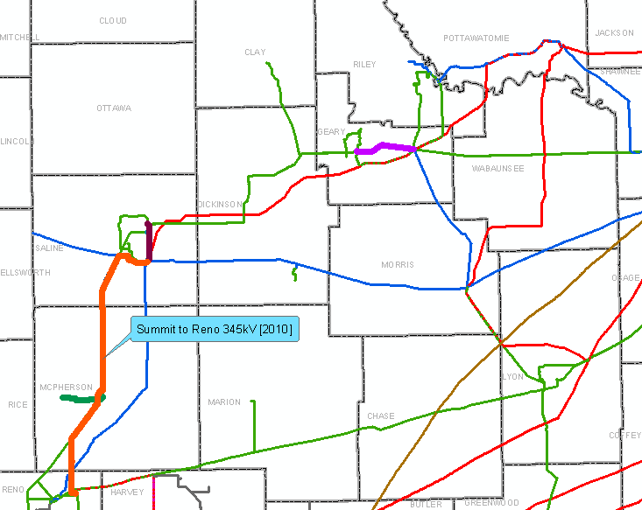

Slide 10
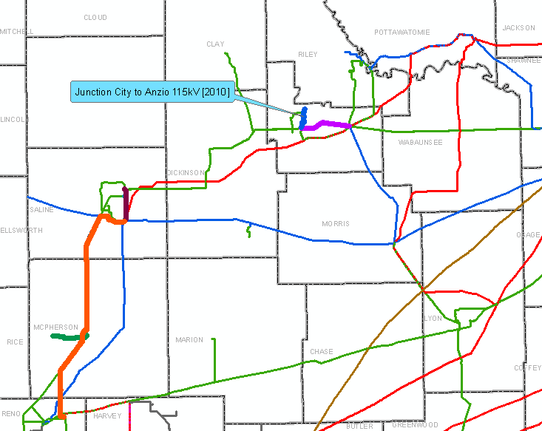

Slide 11
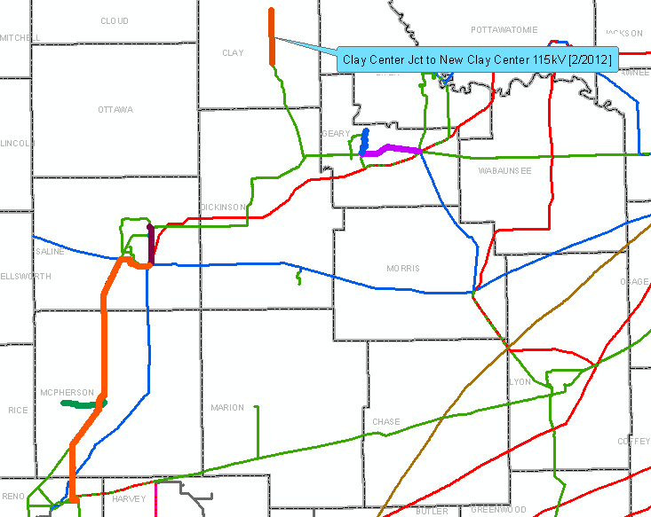
*December, 2012

Slide 12
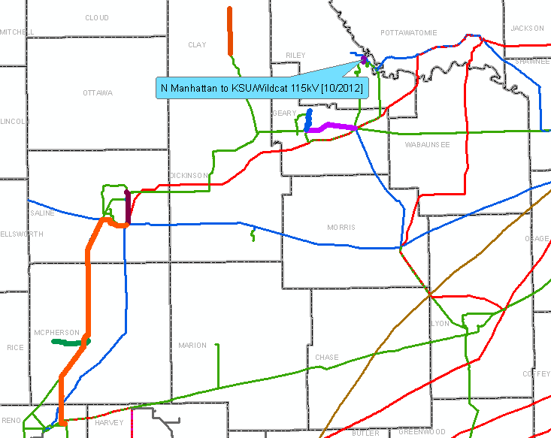

Slide 13
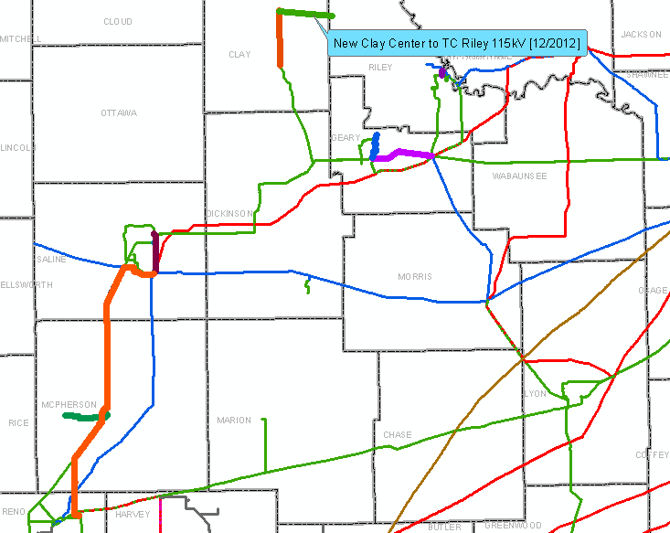
*Moved to 2014 due to TransCanada’s Presidential Permit

Slide 14
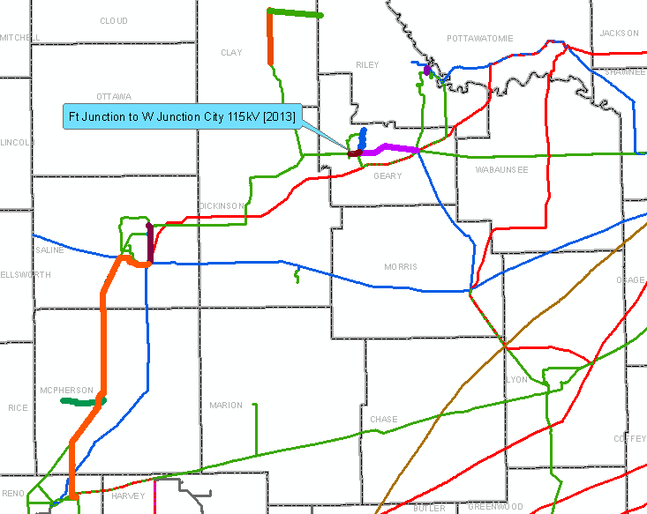

Slide 15
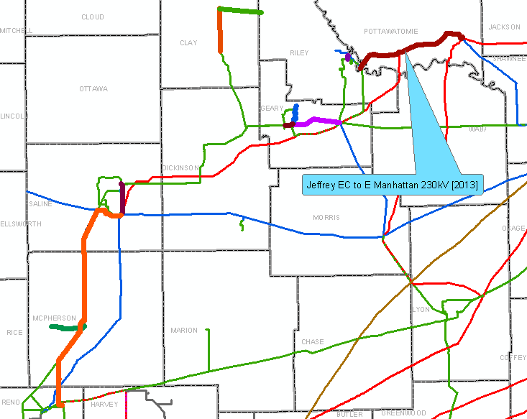
NTC withdrawn. W. Junction City-Chapman Jct (12/13), Chapman Jct-E. Abilene (6/14), E. Abilene-Abilene (12/14), Abilene-Northview (6/15)

Slide 16
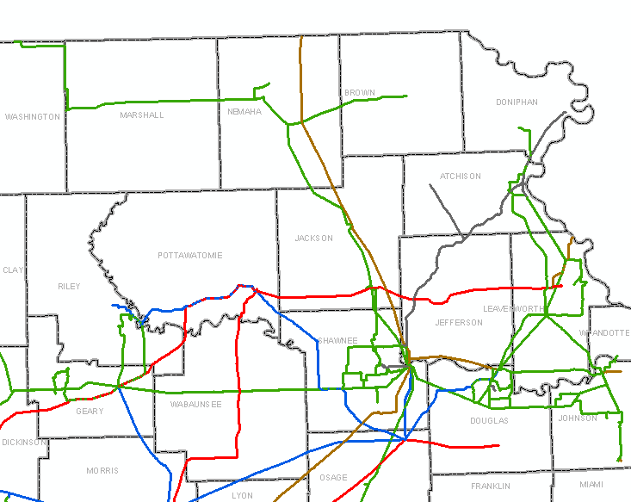
Northeast

Slide 17
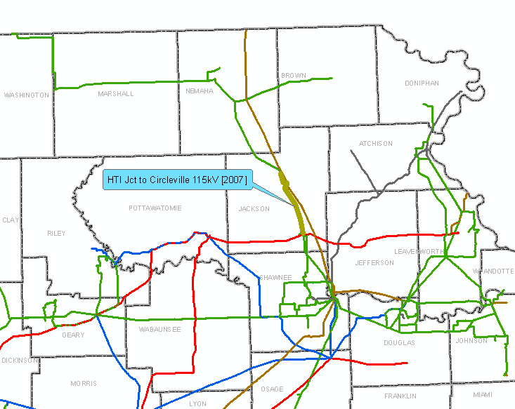

Slide 18
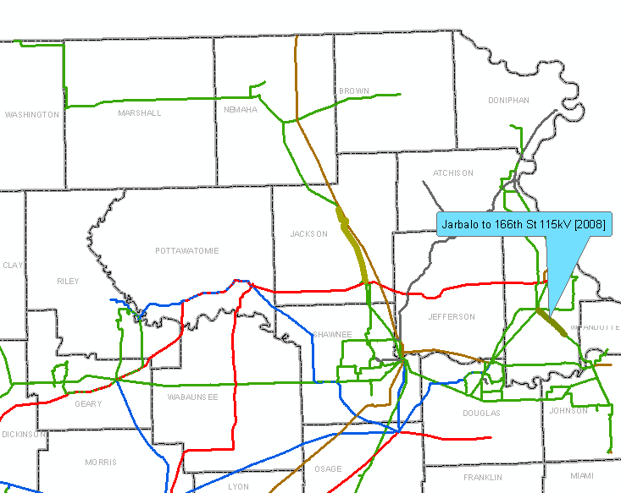

Slide 19
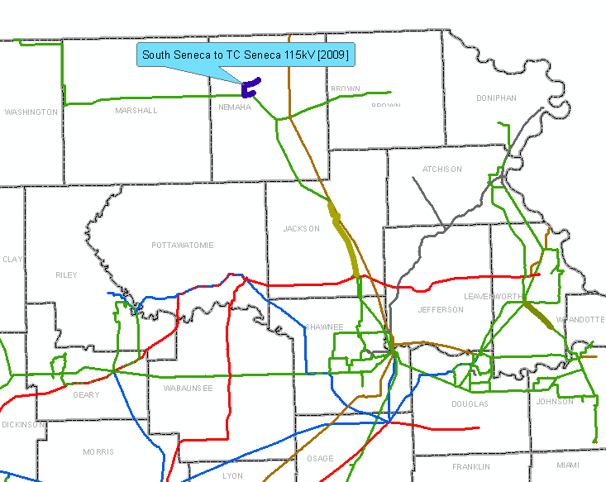
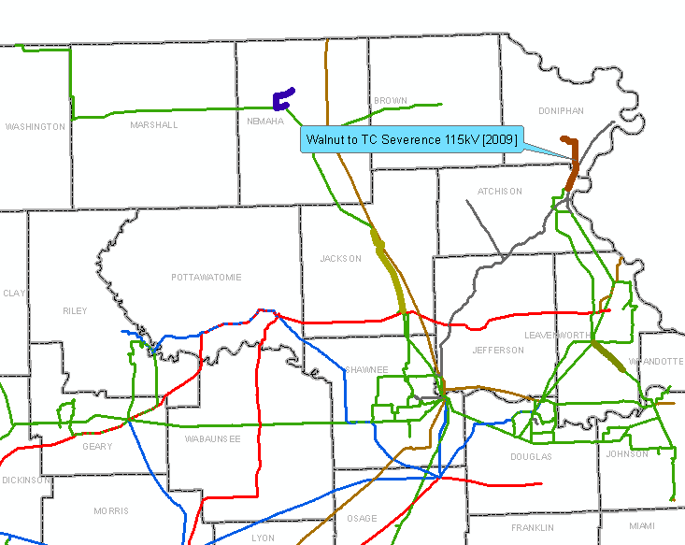
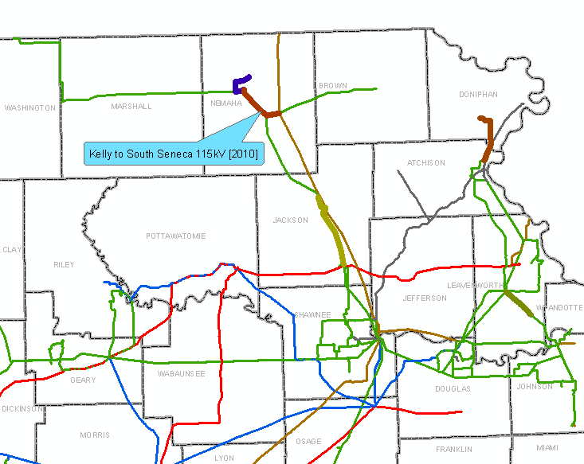

Slide 22
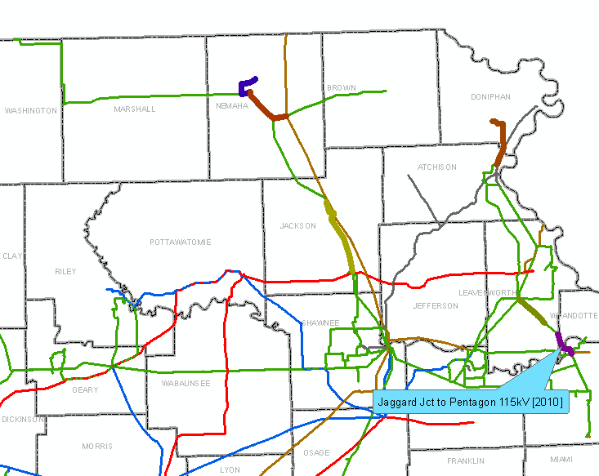

Slide 23
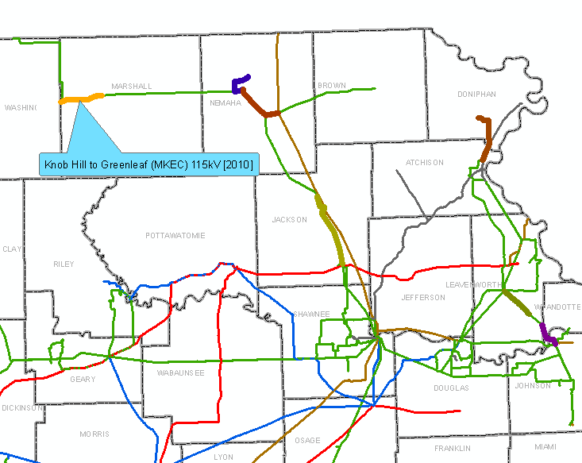

Slide 24
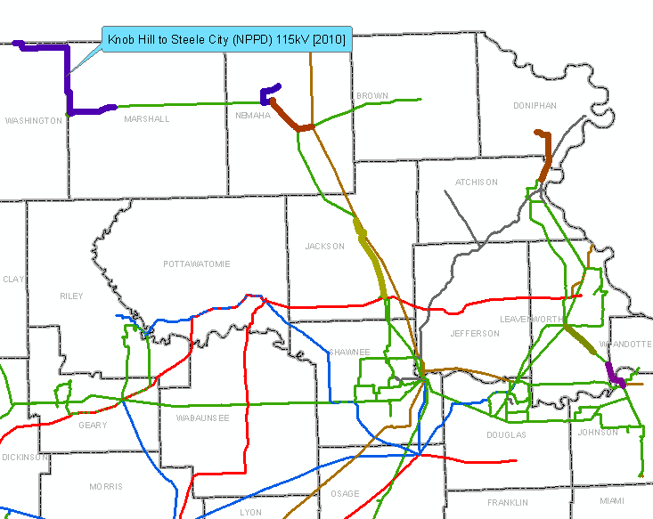

Slide 25
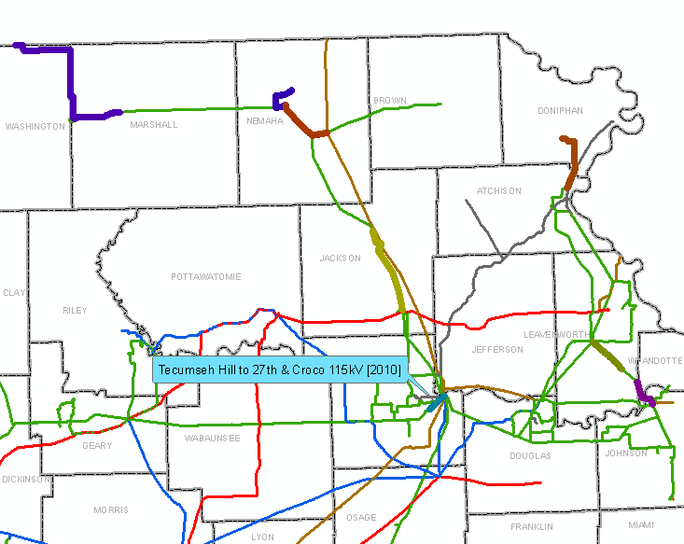

Slide 26
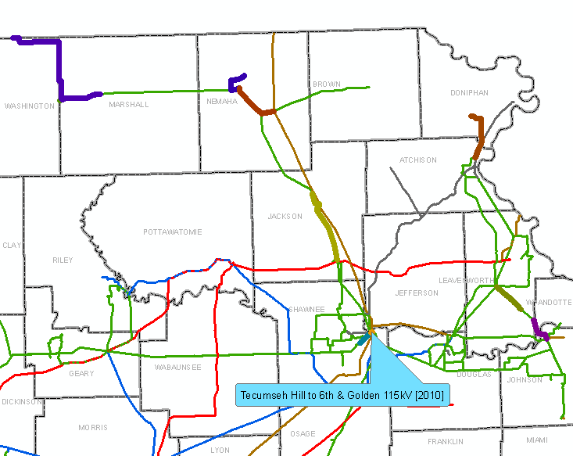

Slide 27
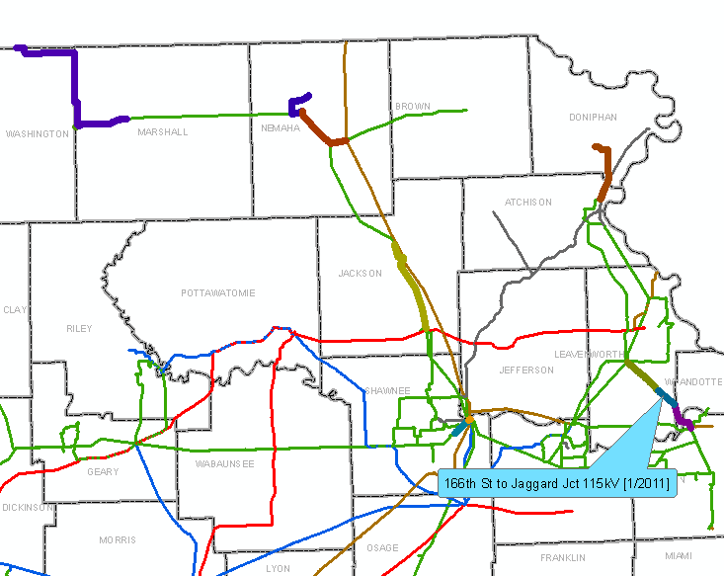

Slide 28
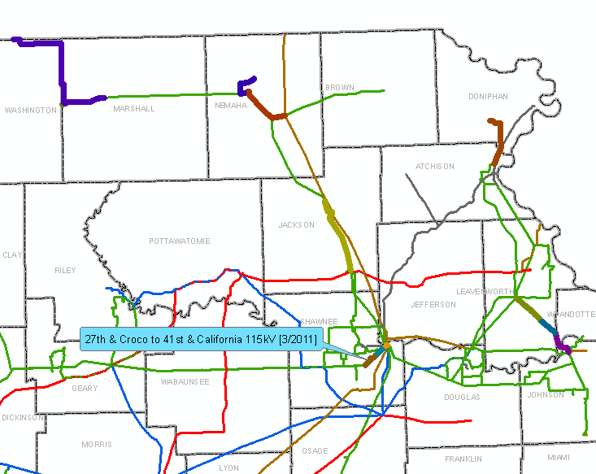

Slide 29
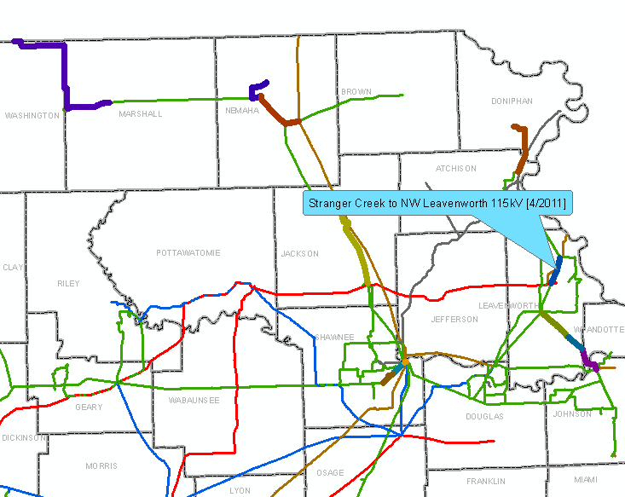

Slide 30
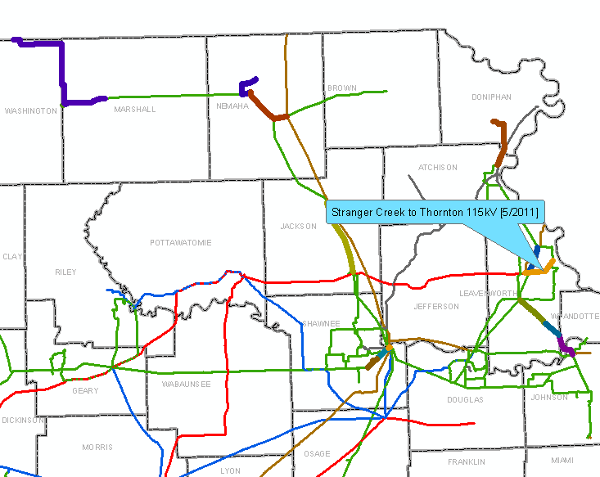

Slide 31
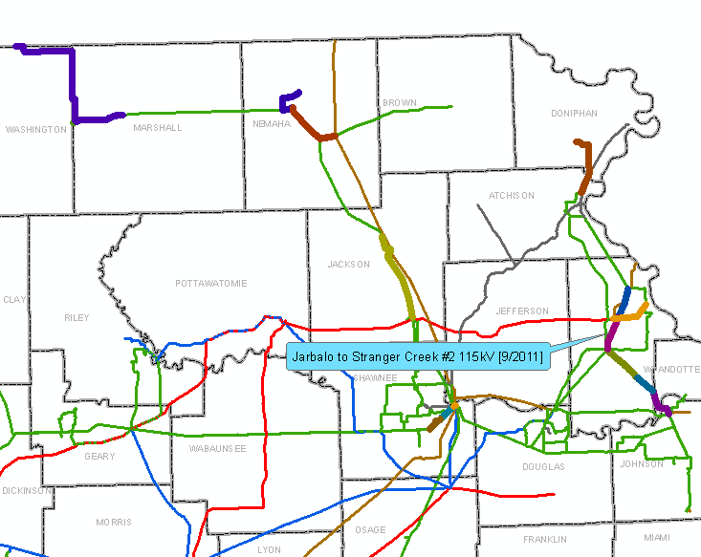

Slide 32
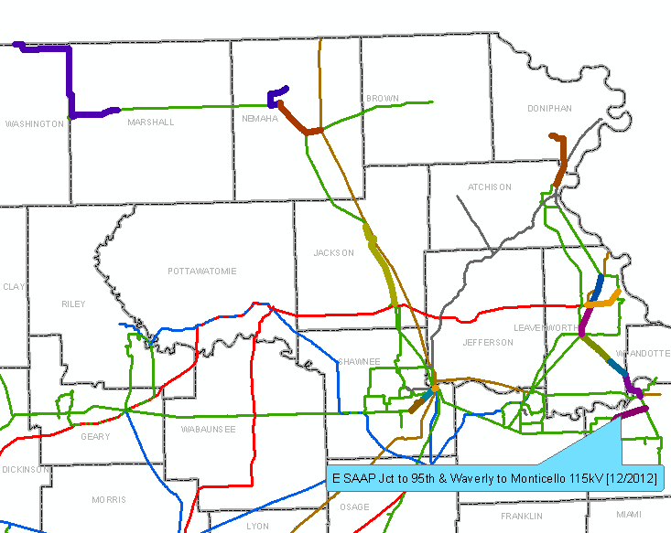

Slide 33
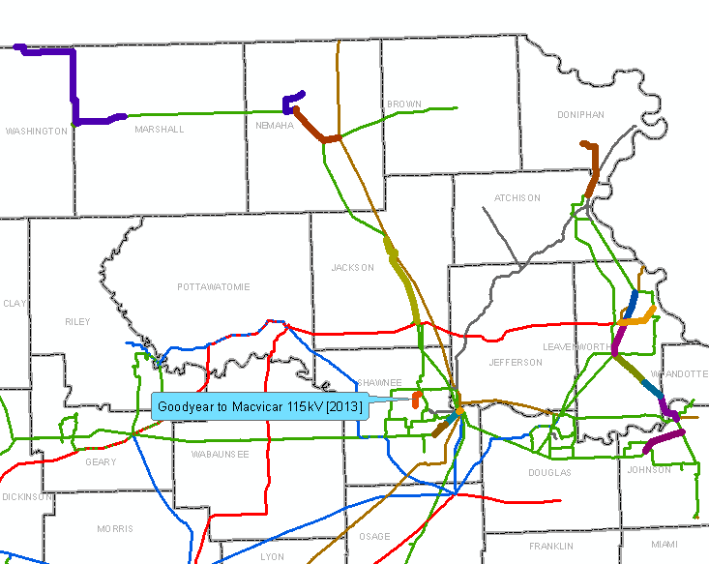

Slide 34
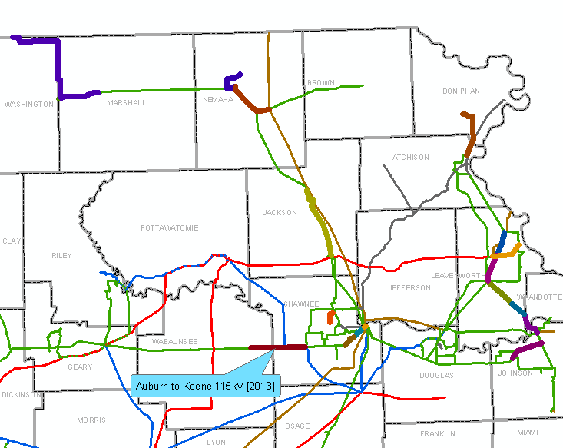
New Date: Auburn-Keene 6/2015

Slide 35
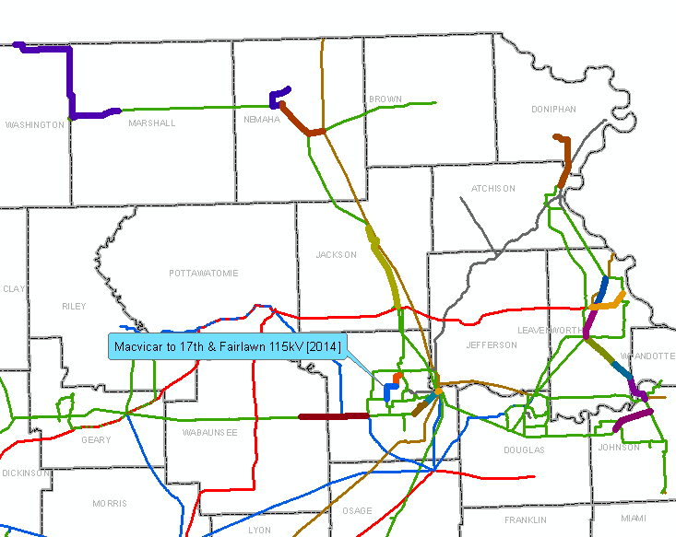

Slide 36
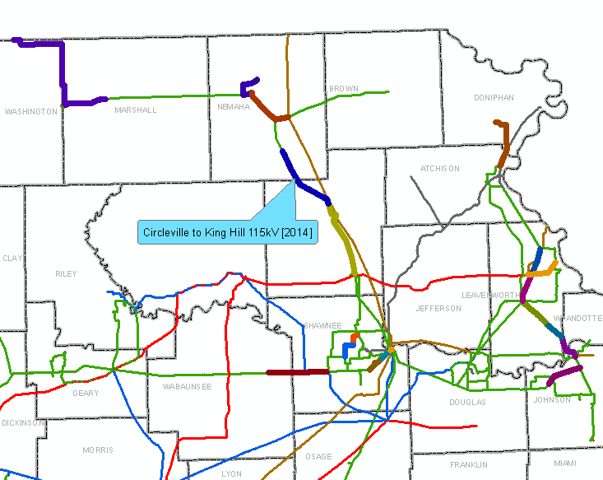
Circleville-King Hill: Moved to 2015

Slide 37
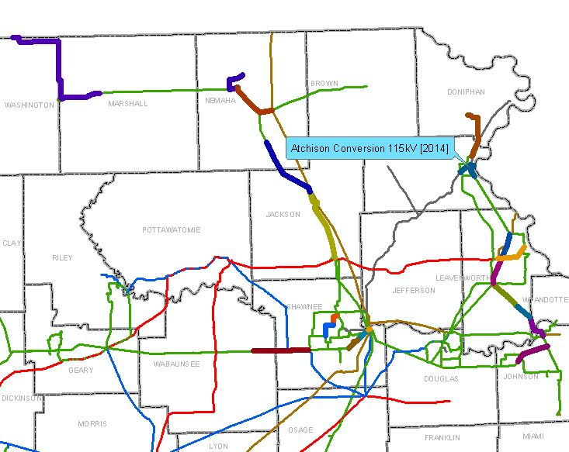
Atchison Rebuilds: Arnold-Atchison Junction (12/2013) Atchison-Kereford (12/2014)

Slide 38
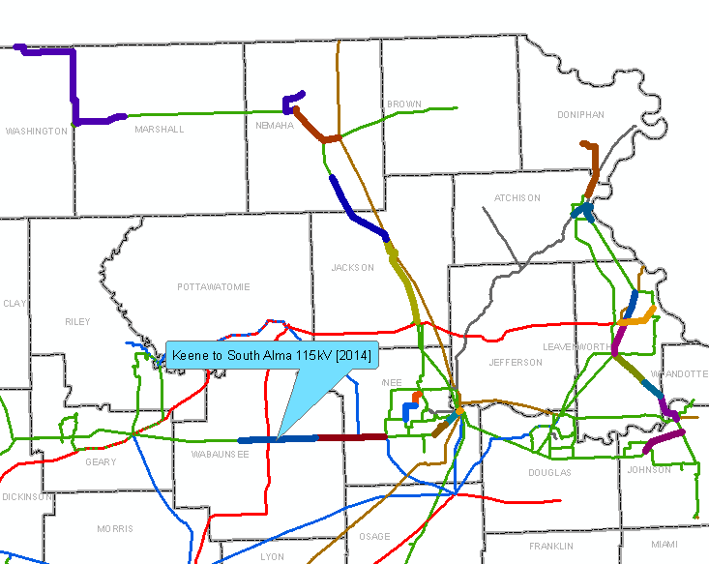
Keene-S. Alma 12/15 following the completion of Auburn-Keene 6/2015

Slide 39
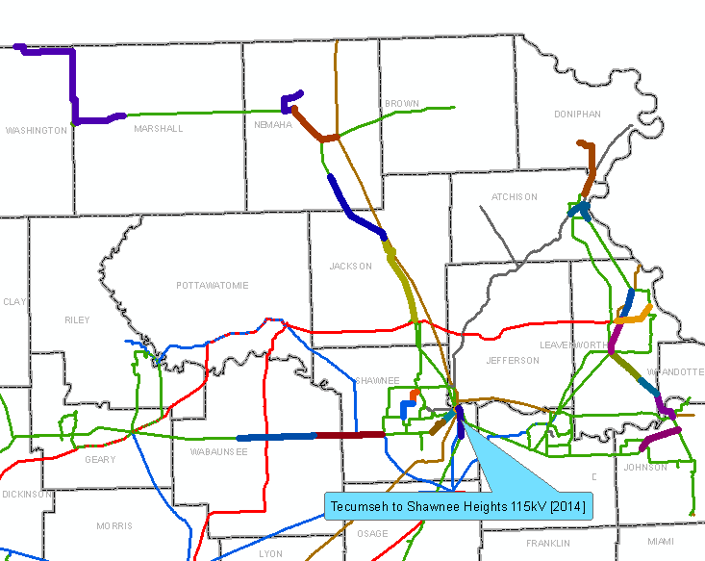
Tecumseh Hill-Shawnee Heights 115 kV line: 12/2012

Slide 40
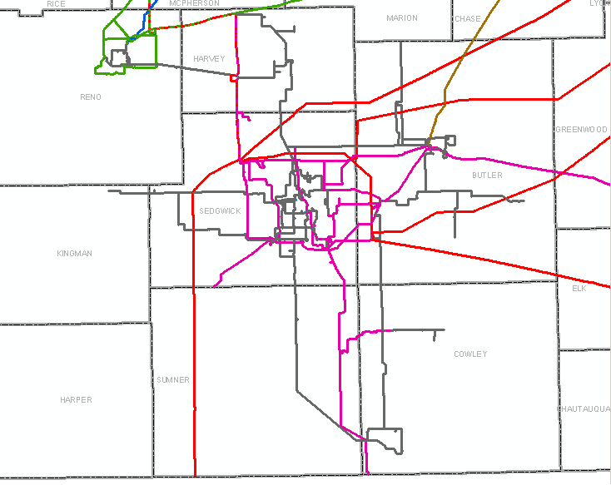
Southwest

Slide 41
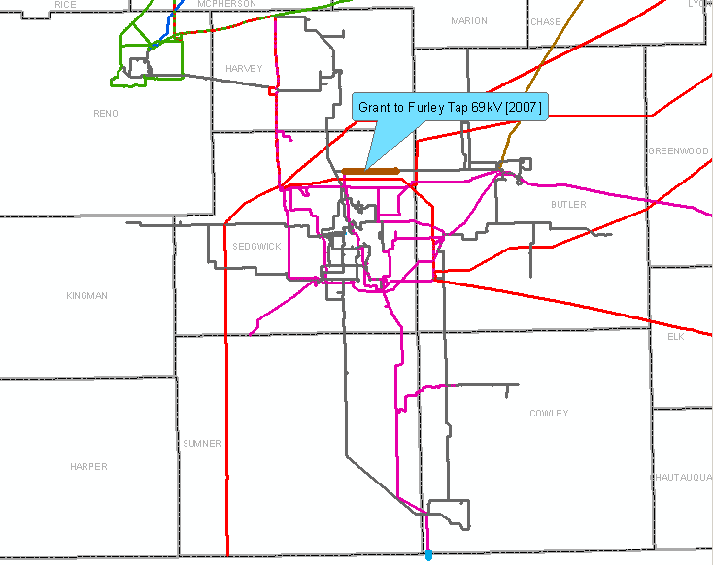

Slide 42
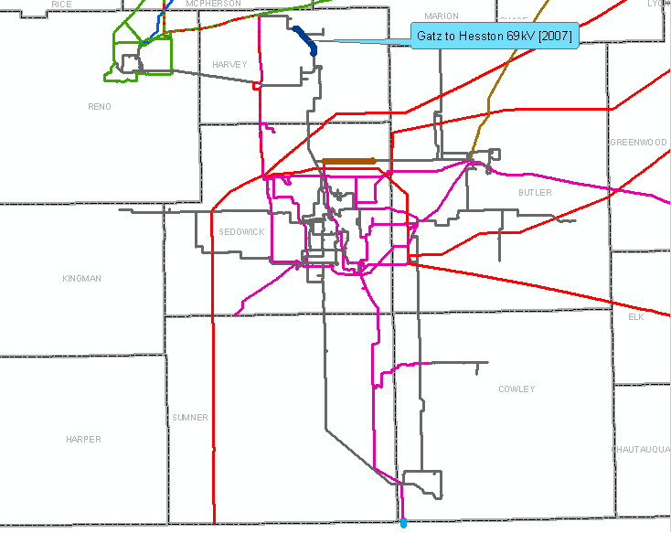

Slide 43
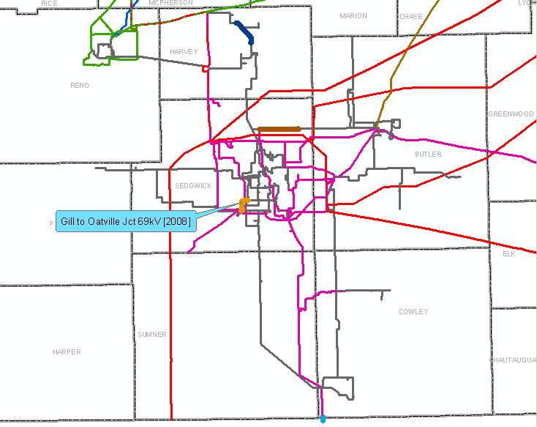

Slide 44
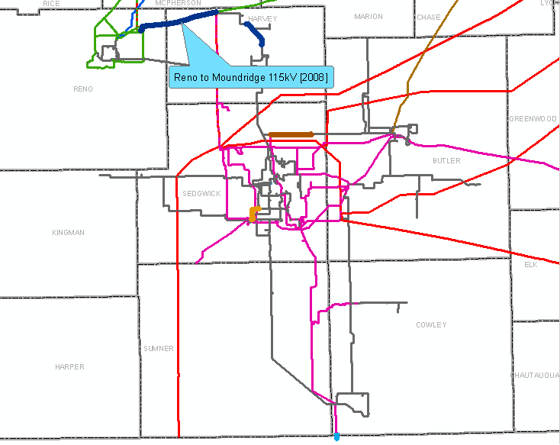

Slide 45
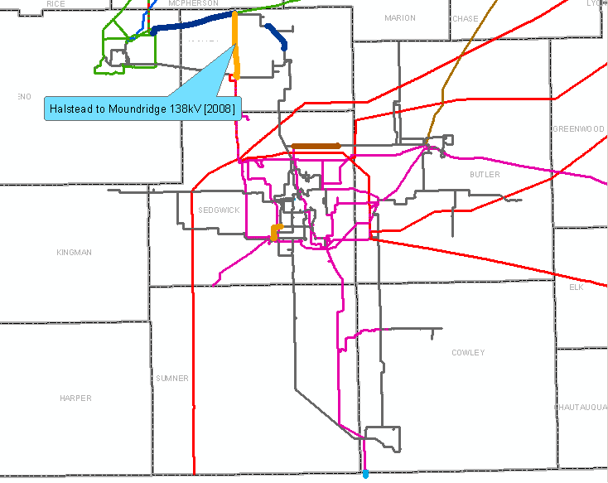

Slide 46
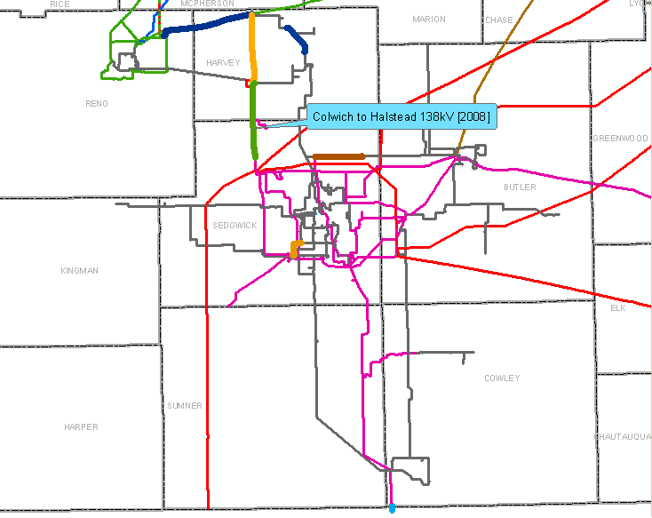

Slide 47
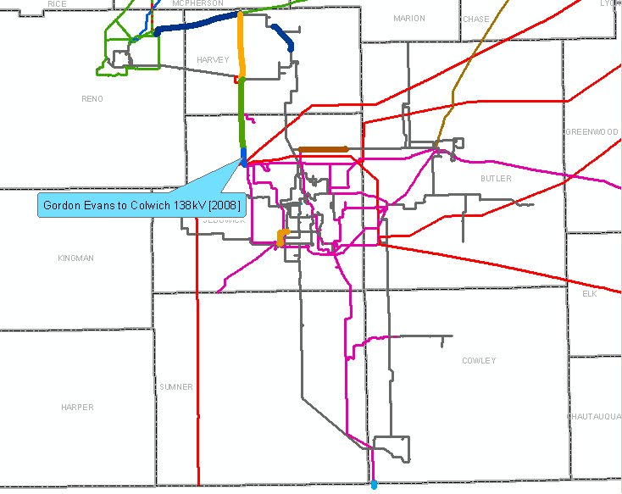

Slide 48
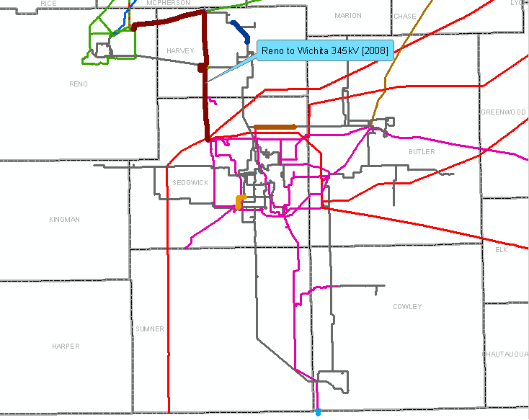

Slide 49
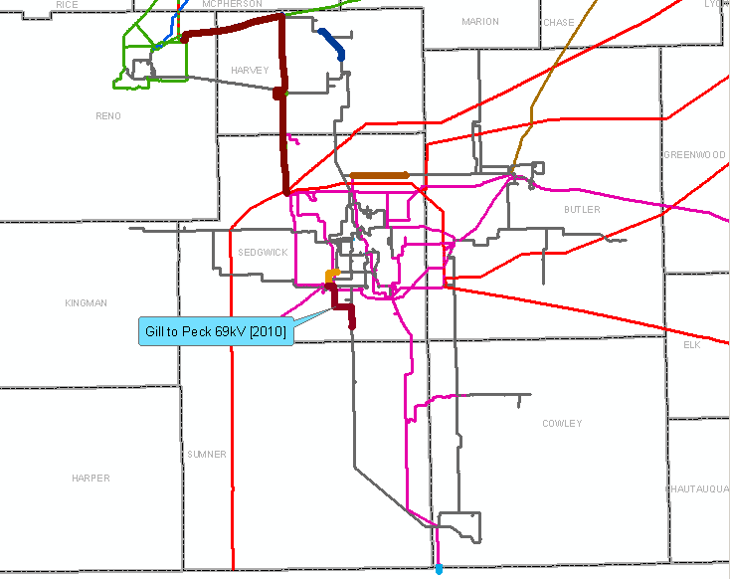

Slide 50
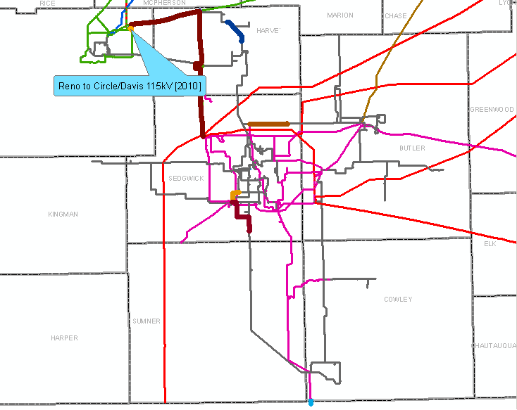

Slide 51
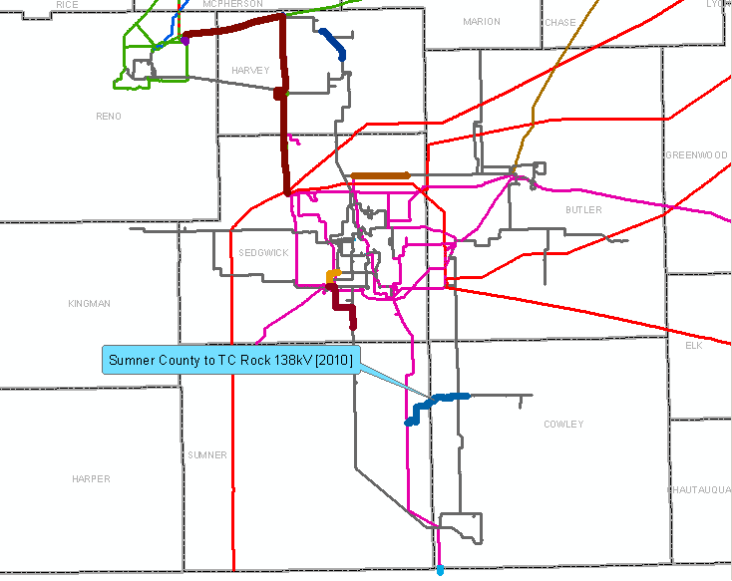

Slide 62
Chase-White Jct: 6/2013

Slide 63
Gill-MacArthur 6/2014

Slide 64
Gill-Waco 138 kV: 12/2012

Slide 66
December, 2012

Slide 69
December, 2012

Slide 70
Moved to 2014 due to TransCanada’s Presidential Permit.

Slide 72
December, 2014

Slide 77
New: Viola 345-138 kV plus double ckt 138 kV to Clearwater and Gill – December, 2014.

Slide 78
Southeast

Slide 85
December, 2012

Slide 86
On hold due to condemnation proceedings

Slide 87
Complete

Slide 88
2014

Slide 89
2014

Slide 93
Franklin: June, 2014
Tioga-Allen 69 kV: December, 2014

Slide 94
2007
2008
2009
2010
2011
2012
2013
2014

