Slide 1
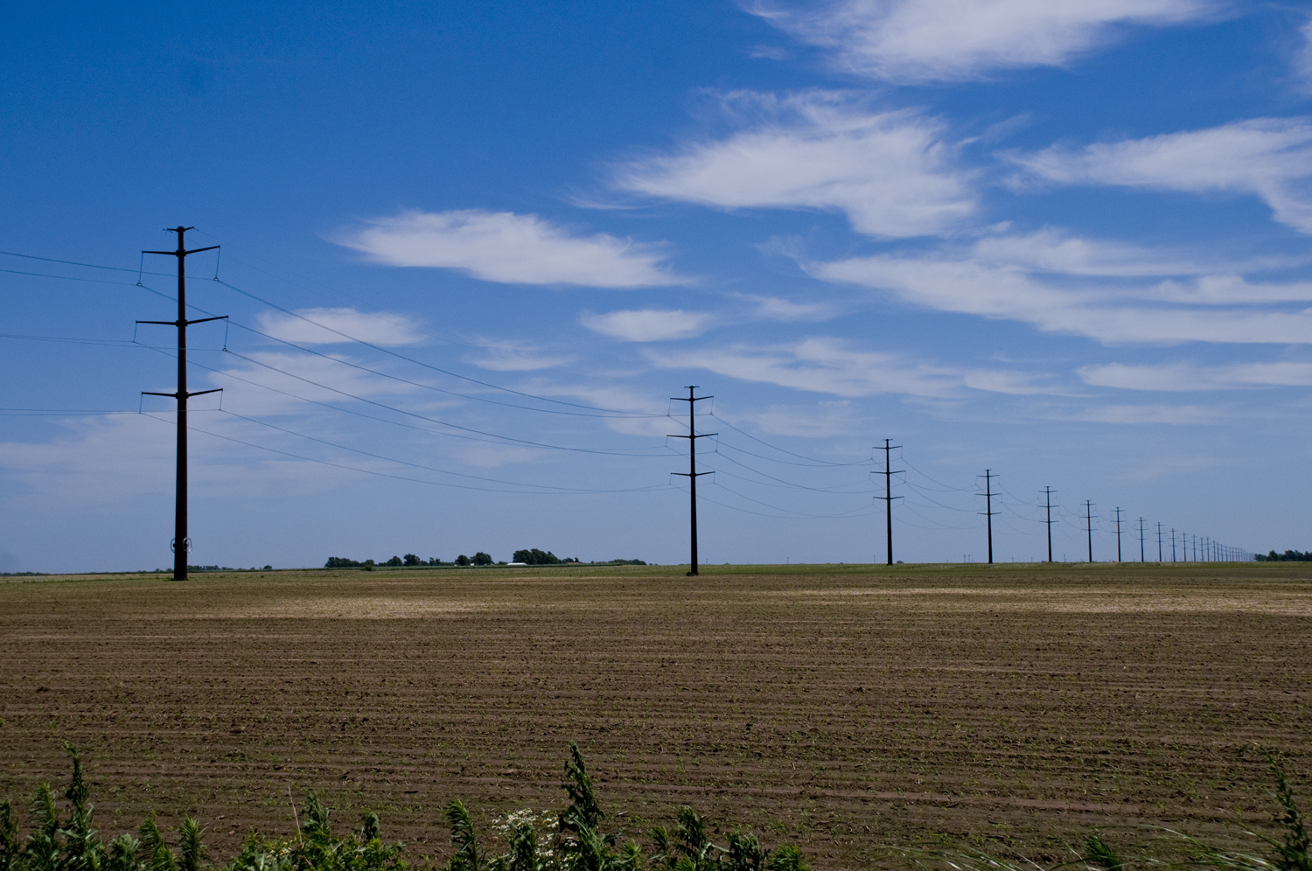
Westar Energy’s 2014 Annual Transmission Revenue Requirement Customer Meeting
October 29, 2013
Westar Energy Headquarters
Topeka, Kansas

Slide 2
Today
Westar Transmission Update
Transmission Construction
Predictive Maintenance Program
Quick Review of the Formula
The Results: 2014 ATRR
The Re-Posting: Reasons and Impacts
Protocol Review

Slide 3
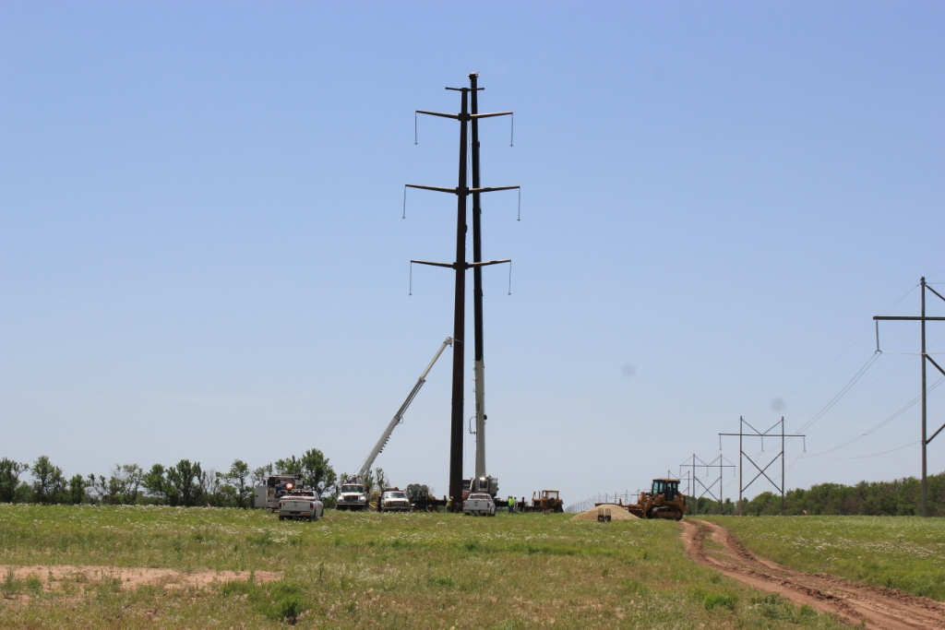
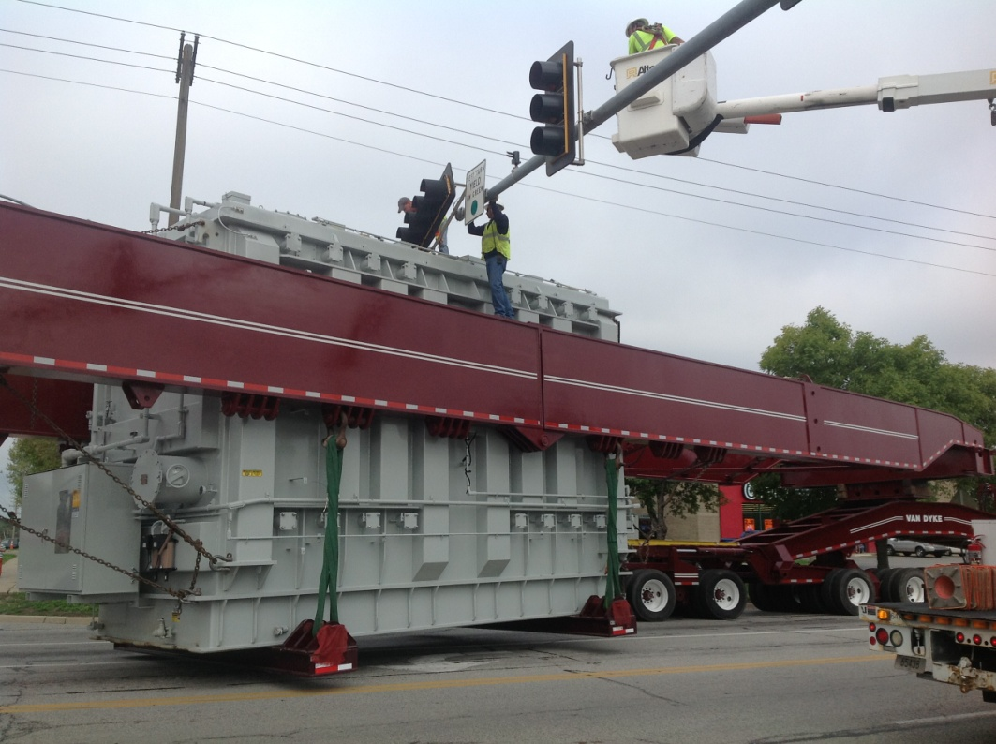
Transmission Construction Status Report
Westar Energy continues to improve its transmission system, impacting almost every region of our territory
Main reasons for improvement projects:
New/modified transmission service requests
Reliability and performance
Load growth
NERC requirements

Slide 4
Transmission Investment
Millions $
Projected
Projected

Slide 5
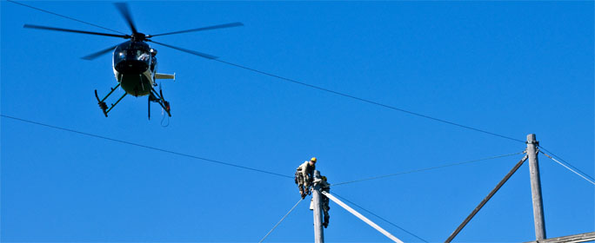
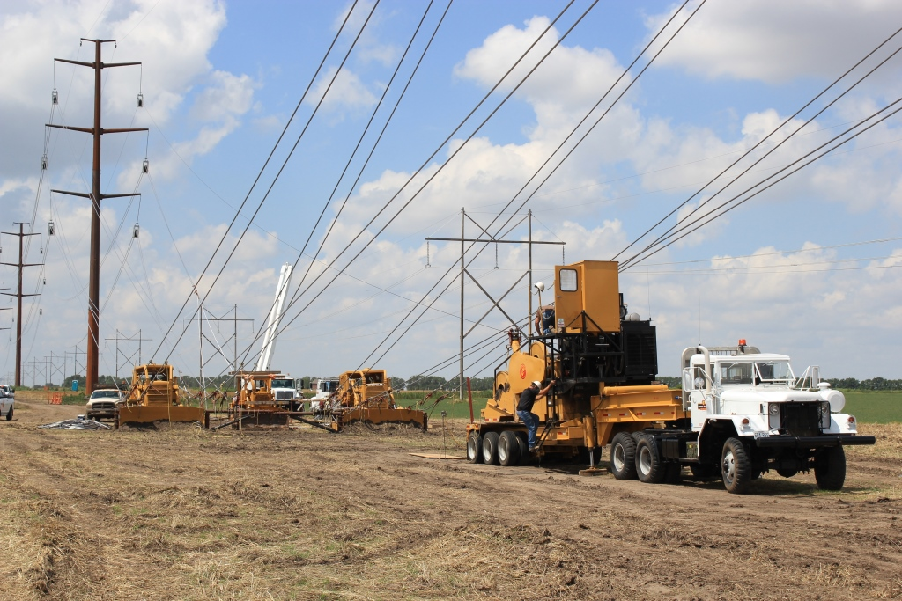
Why Invest in Transmission?
Reliability
The very core of our mission and purpose
Efficiency
Minimizes line losses
More effective use of generation resources
Costs are shared throughout SPP
Economic Development
Increased system capacity supports growth
Improved reliability attracts business
Enables new generation resource development
Supports materials companies, labor

Slide 6
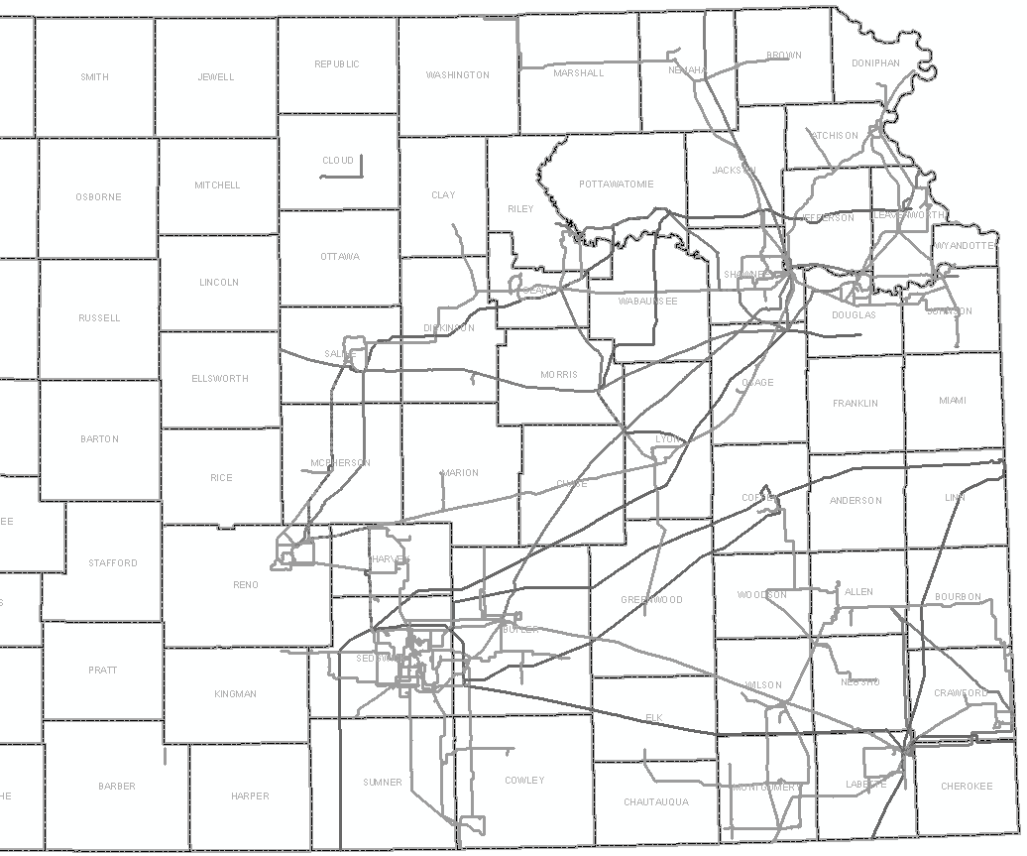
2007
2008
2009
2010
2011
2012
2013
2014
16

Slide 7
Enhanced Predictive Maintenance Program
A strong Predictive Maintenance (PM) Program offers Westar and its customers many benefits:
Improves reliability by finding potential issues before they cause outages
Saves money for our customers and shareholders
Much more efficient, safe way of utilizing resources
Operating in a Proactive vs. Reactive manner is always best
Westar has always had this function, but we’ve greatly enhanced it:
Dedicated department
Root cause analysis after all major transmission events
Example: Helicopter inspection program

Slide 8
PM Program Example: Helicopter Inspections
Helps us find potential issues before they cause an outage
Scanning about 4,000 miles in 2013 (about 75% complete)
Flights are about 100-150 feet above our lines
Gather information about transmission lines using several methods, including:
Infrared thermal scan
UV/Corona scan
HD video
500+ problems identified to date
Repair work is being prioritized by criticality and schedule
Goal: Complete critical repairs by end of Q1 2014
Crews consist of a pilot and a certified thermographer
All data is analyzed real-time by crew members
Work orders have been and/or are being developed based on all findings

Slide 9
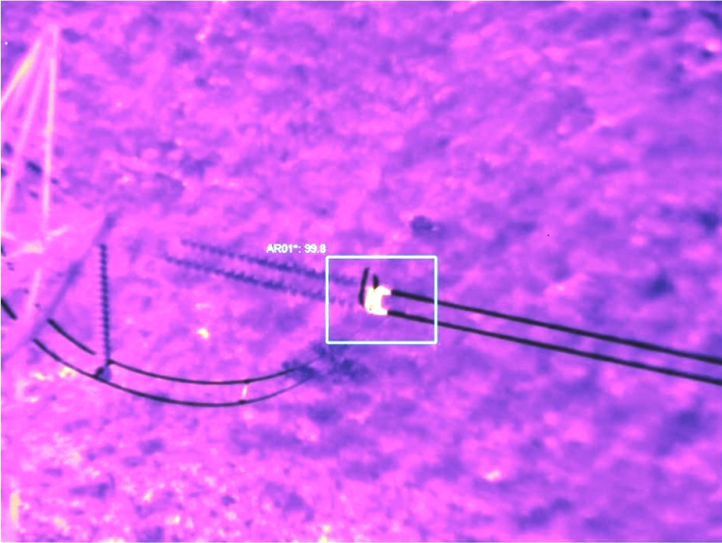
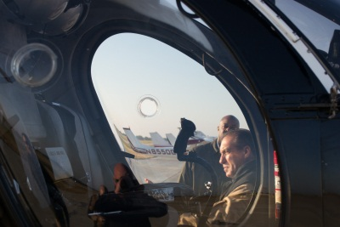
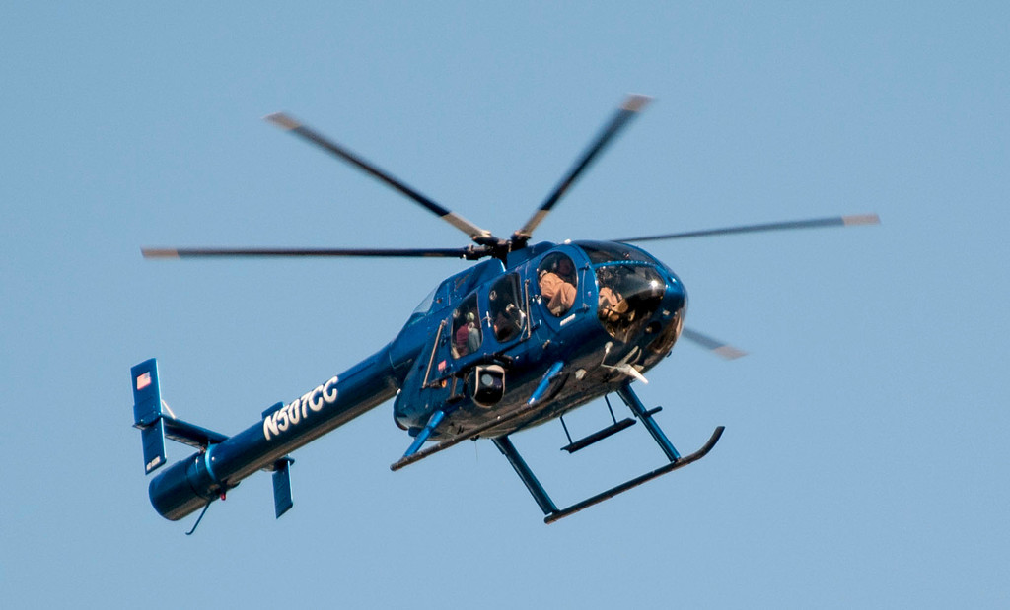
PM Program Example: Helicopter Inspections

Slide 10
PM Program Example: Helicopter Inspections
Found via Corona scan

Slide 11
Quick Review: The Formula
Gross Revenue Requirement (GRR) includes:
Projected Transmission Plant In-Service
Projected Transmission O&M
Projected Transmission Depreciation Expense
Taxes
Return
Net Revenue Requirement adjusts the GRR for:
Revenue Credits received for Point-to-Point Transmission Service
“Rent” received (i.e. pole attachments)
True-Up for prior year’s difference between actual and projected, including interest

Slide 12
The Results: ATRR for 2014
Westar’s Gross Rev. Requirement $242,277,748
Revenue Credits ($ 14,133,041)
True-Up* $ 14,393,016
Westar’s Net Rev. Requirement $242,537,723
SPP’s BPF Rev. Requirement** ($ 81,825,623)
SPP Zonal Rev. Requirement*** $160,712,100
* Includes corrections made to 2011 and 2012 True-Ups
** Funds collected under Schedule 11
*** Resulting rates go into effect with January 2014 business

Slide 13
The Re-Posting: Reasons and Impacts
Adjustments to the “Revenue Credits” component
Originally included revenue from NITS customers who are not connected to Westar’s system for Base Plan Funded (BPF) facilities
Should have only included Point-to-Point revenues
Result: Understatement of BPF and Zonal ATRR
The calculations have been corrected back to and including the 2011 True-Up
TFR Protocols allow corrections for previous18 months
All corrections will be included in 2014 ATRR
True-Up for 2013 (posted in June 2014) will correct this component for the 2013 ATRR
No re-billing will occur

Slide 14
Formula Protocols: Annual Update
Today: October 29, 2013
Comments and questions are preferred by November 15, 2013, so we can review and revise the ATRR if necessary
If necessary, revised ATRR will be posted by November 30, 2013
Send comments or questions via e-mail to:
Melissa Deutsch at melissa.deutsch@westarenergy.com
Please cc: gelene.tiller@westarenergy.com
SAVE THE DATE FOR THE 2013 TRUE-UP MEETING: June 24, 2014

Slide 15
Questions?

