Slide 1
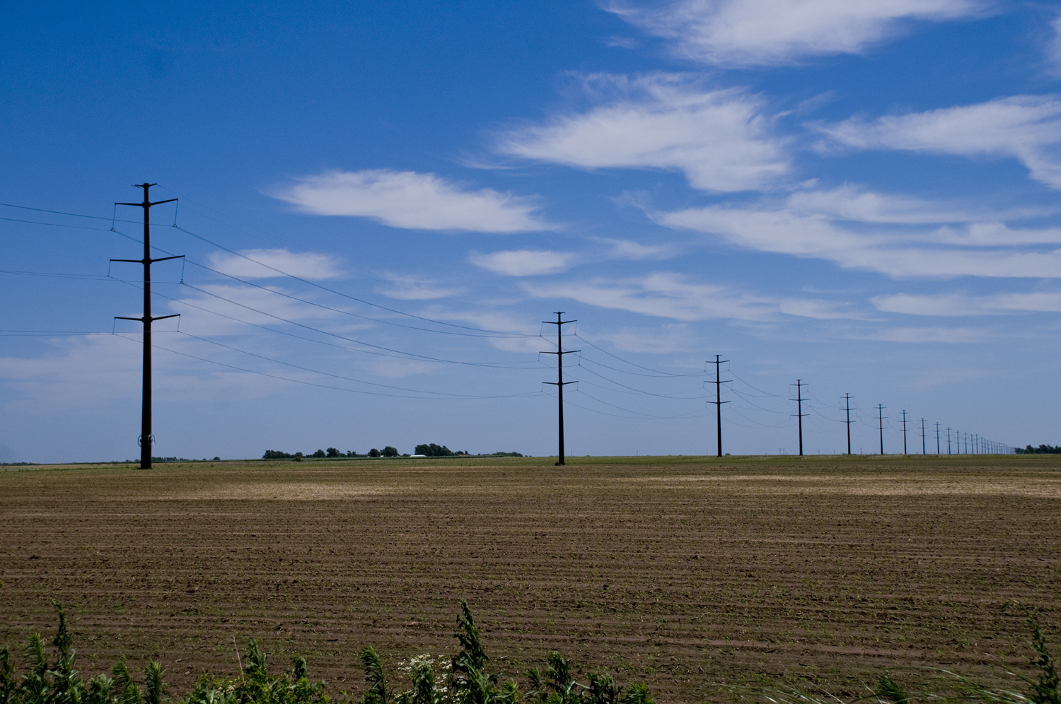
Westar Energy’s 2016 Annual Transmission Revenue Requirement Customer Meeting
October 27, 2015
Westar Energy’s Professional Development Center
Topeka, Kansas

Slide 2
Today
Quick Review of the Formula
The Results: 2016 ATRR
Protocol Review

Slide 3
Quick Review: Westar’s TFR
Gross Revenue Requirement (GRR) includes:
Projected Transmission Plant In-Service
Projected Transmission O&M
Projected Transmission Depreciation Expense
Taxes
Return
Net Revenue Requirement adjusts the GRR for:
Revenue Credits received for Point-to-Point Transmission Service
“Rent” received (i.e. pole attachments)
True-Up for prior year’s difference between actual and projected, including interest

Slide 4
A Refresher of the Timing (Example: 2016 Rate Year)
June 2015: True-up Amount from prior Rate Year (2014) is posted
Next Rate Year (2016) includes the 2014 True-up and 2016 Projected ATRR
October 2015: Projected ATRR for the next Rate Year (2016) is posted

Slide 5
The Results: ATRR for 2016
Westar’s Gross Rev. Requirement $290,235,654
Revenue Credits ($ 22,265,473)
2014 True-Up ($ 8,461,128)
Westar’s Net Rev. Requirement $259,509,053
SPP’s BPF Rev. Requirement* ($ 61,087,437)
SPP Zonal Rev. Requirement** $198,421,616
* Funds collected under Schedule 11
** Resulting rates go into effect with January 2016 business

Slide 6
Formula Protocols: Annual Update
Today: October 27, 2015
Data requests regarding this projection calculation may be submitted until December 14, 2015.
Data requests are preferred as soon as possible so we can review and revise the ATRR if necessary
Westar will make its best effort to respond within 15 business days of the receipt of such requests
Send data requests via e-mail to:
Tanner Wealand at Tanner.Wealand@WestarEnergy.com
Please cc: Julie.Lux@WestarEnergy.com AND Suzanne.Lane@WestarEnergy.com

Slide 7
FERC Activity
For the Westar TFR ROE:
Docket #EL14-93
August 20, 2014 – Original Filing
August 3, 2015 – Settlement Agreement Filed (9.8% base ROE)
TBD – Order Accepting Settlement
TFR will be revised and re-posted after Order is issued
For the Westar TFR Protocols:
Docket #ER14-2852
July 17, 2014 – Original Filing
March 19, 2015 – Order on Compliance Filing
New protocols became effective March 1, 2015
Email Michelle Harris at mharris@spp.org to be added to the SPP Service List
May 15, 2015 – Compliance Filing
June 12, 2015 – Answer to Protest
TBD – Final Order

Slide 8
Questions?
SAVE THE DATE FOR THE 2015 TRUE-UP MEETING: June 28, 2016
Thank you for your participation!
Safe travels!

