Slide 1
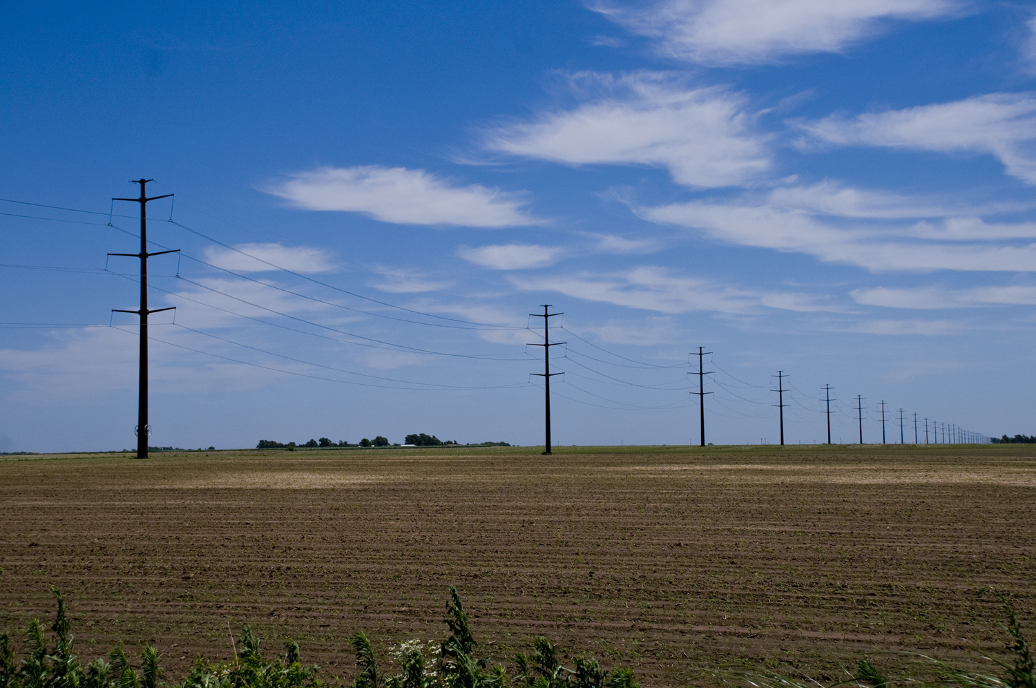
Westar Energy’s 2012 Annual Transmission Revenue Requirement
True-Up Meeting
June 26, 2012

Slide 2
Today
Quick Review
The Results: 2011 Actual ATRR vs. Projected 2011 ATRR
Why is there a Difference Between the Actual and Projected?
Protocol Review

Slide 3
Quick Review: The Formula (True-Up)
Gross Revenue Requirement (GRR) includes:
Actual Transmission Plant
Actual Transmission O&M
Actual Transmission Depreciation Expense
Taxes
Return
Net Revenue Requirement adjusts the GRR for:
Revenue Credits received for Point-to-Point Transmission Service
“Rent” received (i.e. pole attachments)
Note: Actuals used to determine true-up do not include any projections or previous years’ true-up adjustments

Slide 4
The Results: Projected vs Actual ATRR for 2011
Projected Actual
Westar’s Zonal Rev. Requirement $139,500,048 $128,947,410
SPP’s BPF Rev. Requirement** $ 26,193,279 $ 27,423,062
Westar’s Net Rev. Requirement $165,693,327* $156,370,472
True-Up Amount (before interest)*** ($ 9,322,855)
* 2011 Projected Net Revenue Requirement without the 2009 True-Up
** Funds collected under Schedule 11
*** Credit to be applied to 2013 ATRR (plus interest), in the rates effective January 1, 2013

Slide 5
Why the Difference?
The Key Reason:
2011 Actual O&M was about $10 million lower than Projected O&M
The TFR calculates a projected O&M based on the percentage increase in Transmission Plant times the actual O&M from the previous actual year
This function of projecting O&M is part of the FERC-approved TFR

Slide 6
Formula Protocols: Annual Update
Today: June 26, 2012
Data requests regarding this true-up calculation may be submitted until September 10, 2012
Westar will make its best effort to respond within 10 business days of the receipt of such requests
Send comments or data requests via e-mail to:
Sheila Gropp at sheila.gropp@westarenergy.com
Please cc: gelene.tiller@westarenergy.com and suzanne.lane@westarenergy.com

Slide 7
Summary
Thank you very much for participating in today’s meeting!
We are here to assist in any way possible.
Please let us know if you have any questions.
Safe travels home!
SAVE THE DATE FOR THE 2013 ANNUAL ATRR MEETING: October 30, 2012

