Slide 1
Transmission Formula Rate Annual True-Up Customer Meeting
June 23, 2015

Slide 2
Today’s Agenda
Welcome and Introductions
Transmission Project Status Report
Westar TFR True-Up Discussion
Prairie Wind TFR True-Up Discussion
Questions

Slide 3
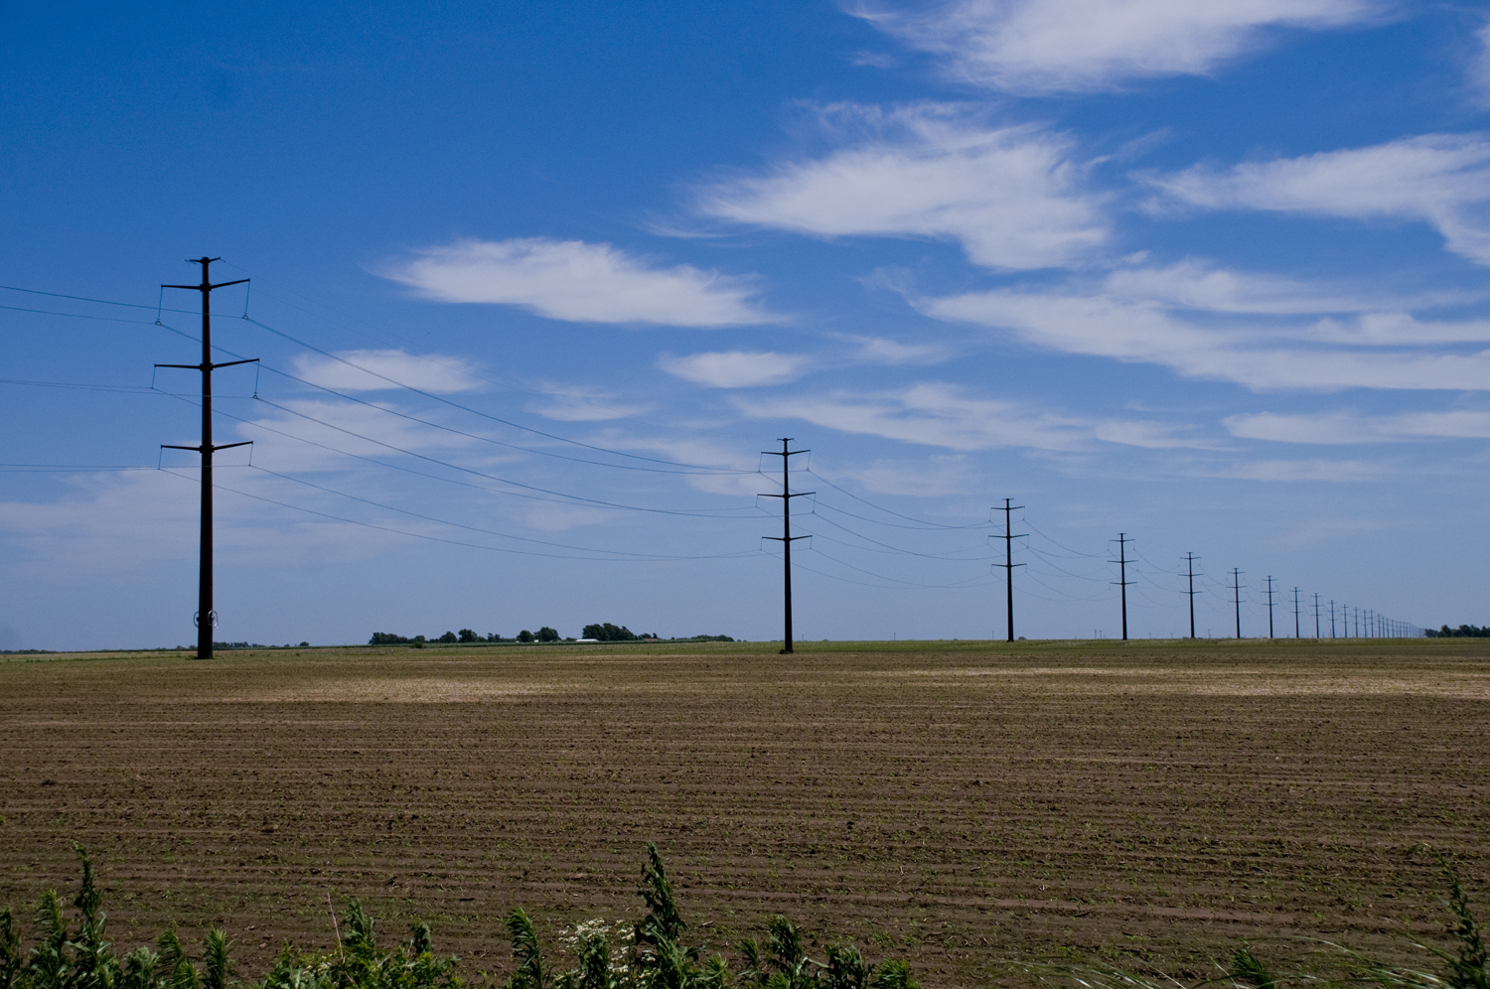
Westar Energy’s 2015 Mid-Year Transmission Project Status Report
June 23, 2015

Slide 4
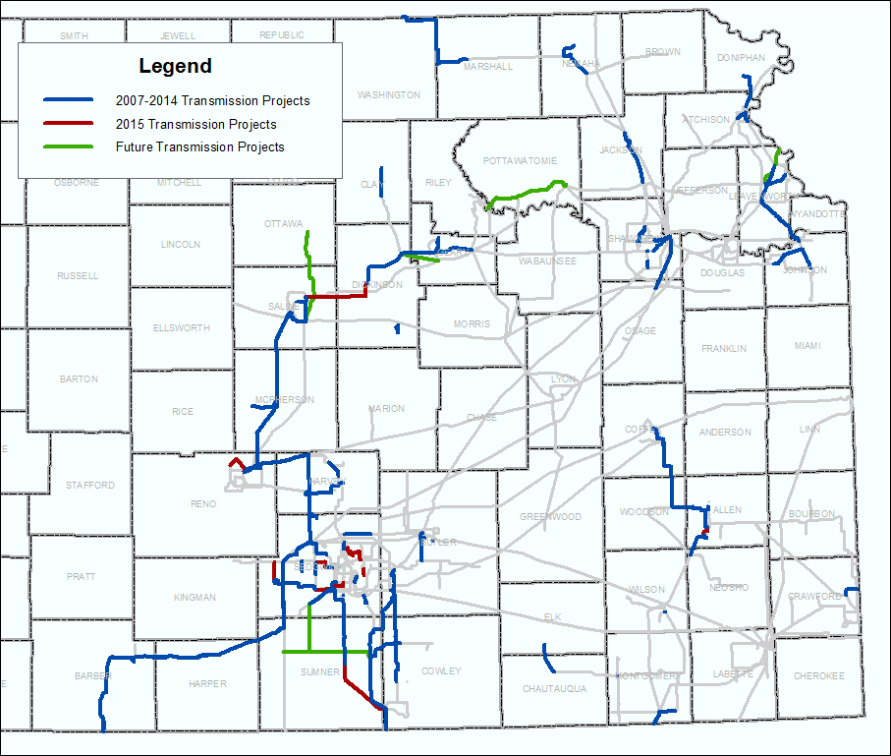

Slide 5
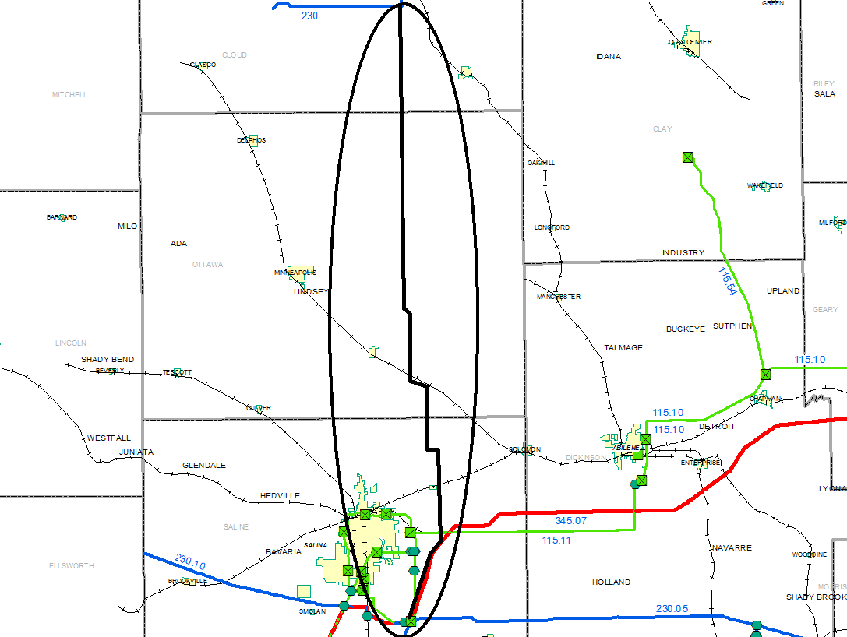
345 kV Project: Summit–Elm Creek
Westar’s Summit Sub to ITC’s Elm Creek Sub
Currently scheduled to be completed by the end of 2016

Slide 6
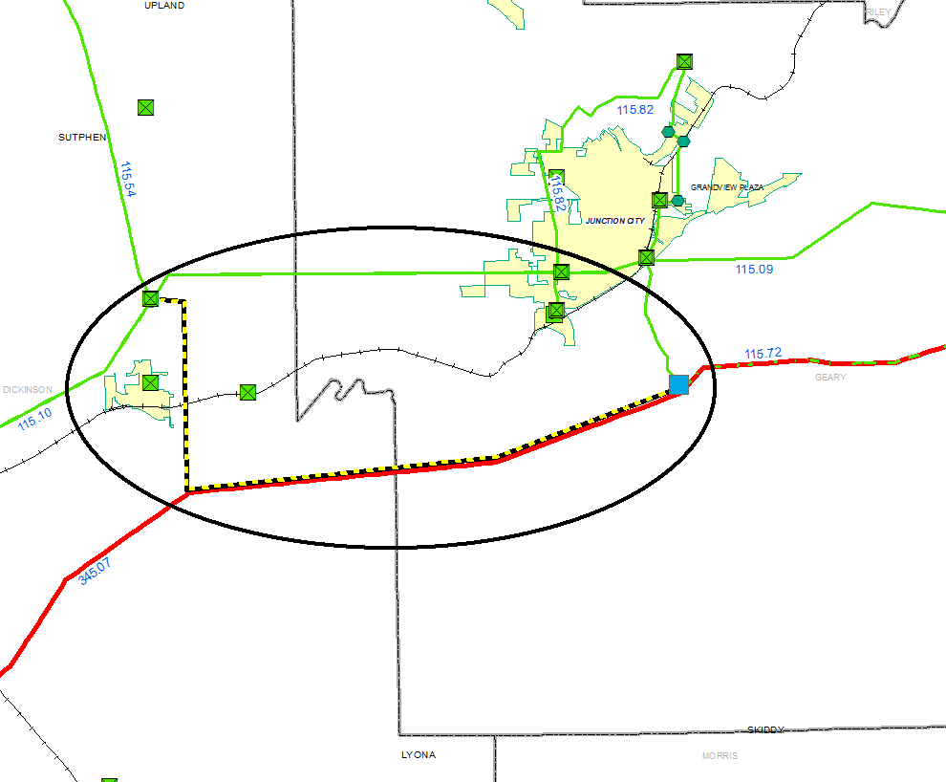
345 kV Project: Geary Co. Substation
A new 345-115 kV substation and new 115 kV line to Chapman Junction
Sub is currently scheduled to be completed by the summer of 2017; line by summer of 2018

Slide 7
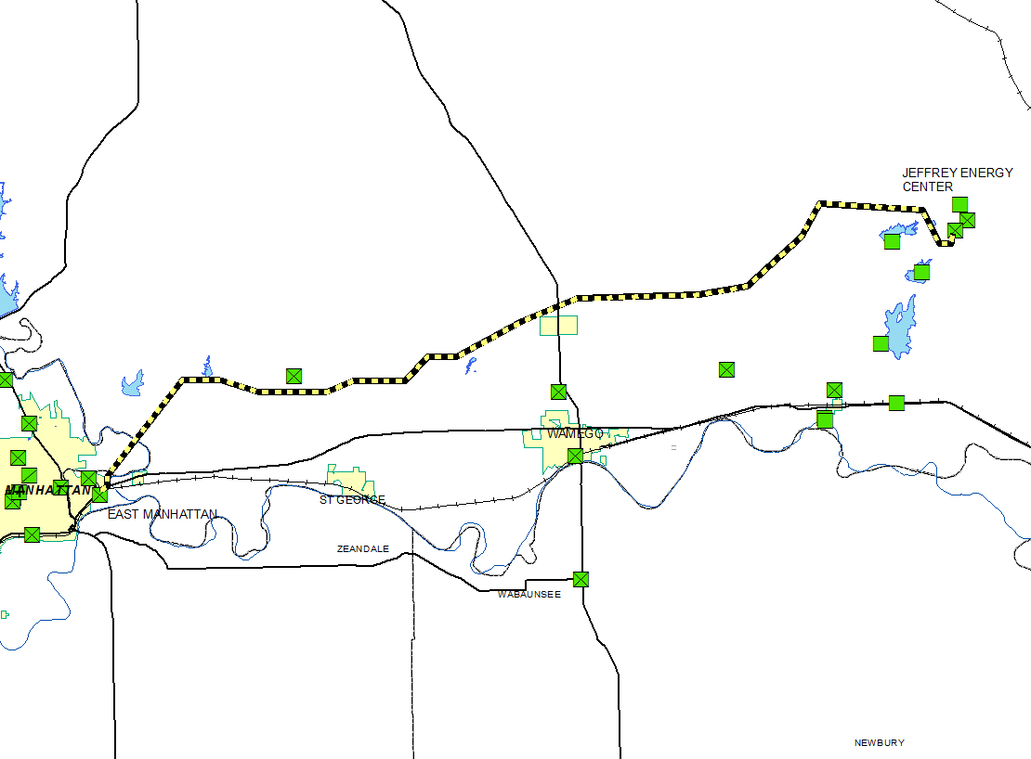
230 kV Project: JEC to East Manhattan
Rebuild of the existing 230 kV line
Currently scheduled to be completed by the summer of 2017

Slide 8
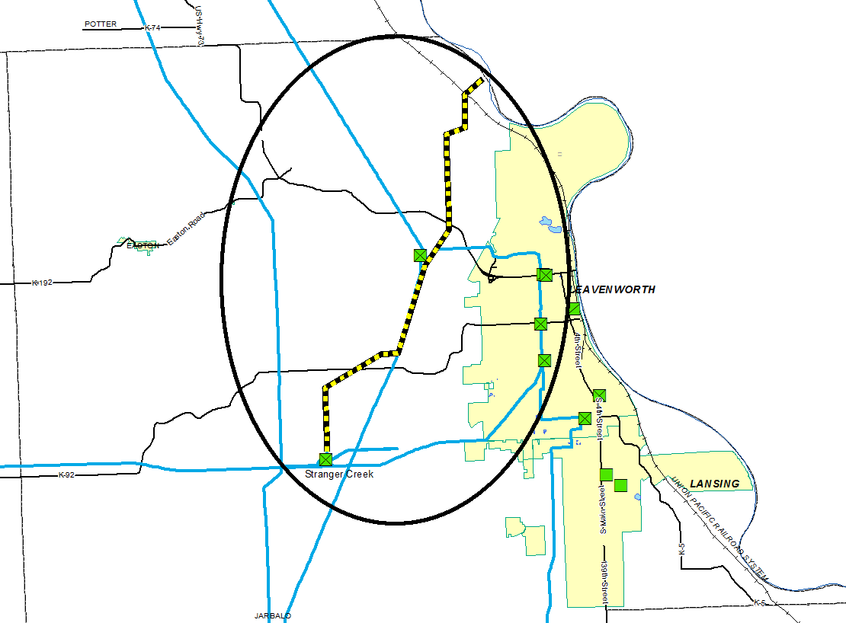
161 kV (to 345 kV) Project: Stranger Creek to Iatan (KCPL)
Rebuild of the existing 161 kV line and converting it to 345 kV
Currently scheduled to be completed by the end of 2018

Slide 9
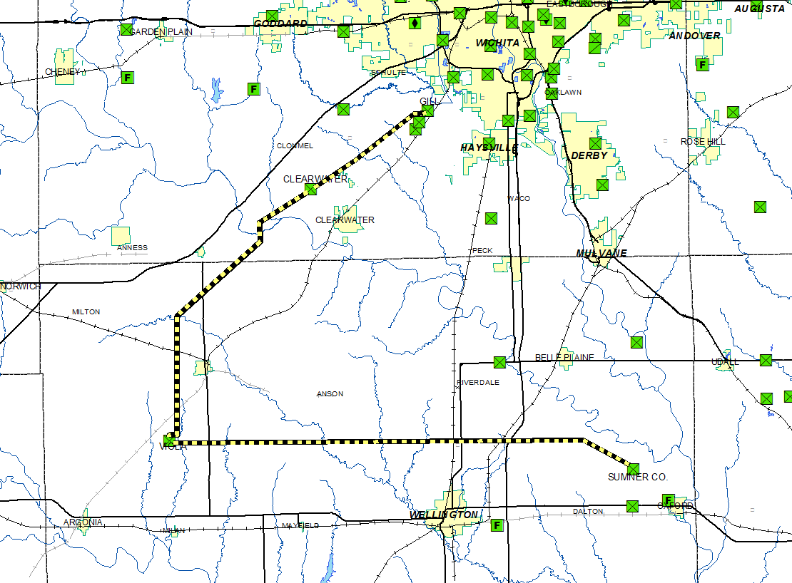
138 kV Project: New Lines out of Viola Sub
Viola-Clearwater-Gill is currently scheduled to be completed by summer of 2019
Viola-Sumner County is currently scheduled to be completed by summer of 2020

Slide 10
Questions?

Slide 11
Westar Energy’s Annual Transmission Revenue Requirement
True-Up Meeting for Rate Year 2014
June 23, 2015

Slide 12
Useful Resources
For the Westar TFR:
http://www.oatioasis.com/WR/index.html
All related documents are in the folders on the left side of the screen.
For the Prairie Wind TFR:
http://sppoasis.spp.org/documents/SWPP/MemberRelatedPostings/MemberRelatedPostings.asp
Click “Prairie Wind Information” to find all related documents.

Slide 13
Today
Quick Review of the Westar Energy Transmission Formula
The Results: 2014 Actual ATRR vs. Projected 2014 ATRR
Protocol Review

Slide 14
Quick Review: The Westar Transmission Formula (True-Up)
Gross Revenue Requirement (GRR) includes:
Actual Transmission Plant
Actual Transmission O&M
Actual Transmission Depreciation Expense
Taxes
Return
Net Revenue Requirement adjusts the GRR for:
Revenue Credits received for Point-to-Point Transmission Service and revenue received from Network customers outside the Westar pricing zone
“Rent” received (i.e. pole attachments)

Slide 15
A Refresher of the Timing (Example: 2016 Rate Year)
June 2015: True-up Amount from prior Rate Year (2014) is posted
Next Rate Year (2016) includes the 2014 True-up and 2016 Projected ATRR
October 2015: Projected ATRR for the next Rate Year (2016) is posted

Slide 16
The Results: Projected vs Actual ATRR for 2014
 | Projected | Actual
Westar’s Gross Rev. Requirement | $242,277,748 | $242,689,973
Revenue Credits | ($ 14,133,041) | ($22,265,473)
Westar’s Net Rev. Requirement | $228,144,707 * | $220,424,499
True-Up Amount ** (before interest) |  | ($7,720,208)
* 2014 Projected Net Revenue Requirement without the 2013 True-Up
** Amount to be applied to 2016 ATRR (plus interest), in the rates effective January 1, 2016

Slide 17
Updated Westar Formula Protocols
New Protocols were effective March 1, 2015
All TFR notifications will be provided to the SPP “Service List” exploder. Please sign up if you want to continue receiving notifications.
Data Request Period (still being discussed, could possibly change)
75 calendar days after the Annual True-Up Meeting
60 calendar days after the Annual Projection Publication Date
Westar has 15 calendar days to respond to DRs

Slide 18
Updated Westar Formula Protocols
Challenge Procedures
Can make an Informal Challenge to Westar by January 31st
Westar will make every effort to respond in 20 days
Can make a Formal Challenge at FERC until March 31st
Westar will submit to FERC an informational filing of its Annual Projection, including its Annual True-Up, by March 15th each year

Slide 19
A Review of Westar Formula Protocols
Today: June 23, 2015
Data requests regarding this true-up calculation may be submitted until September 8, 2015
Westar will make its best effort to respond within 15 business days of the receipt of such requests
Send comments or data requests via e-mail to:
Donna Lehman at donna.lehman@westarenergy.com
Please cc: gelene.tiller@westarenergy.com and suzanne.lane@westarenergy.com

Slide 20
Summary
Thank you very much for participating in today’s meeting!
We are here to assist in any way possible.
Please let us know if you have any questions.
SAVE THE DATE FOR THE 2016 ANNUAL WESTAR ATRR MEETING: October 27, 2015

Slide 21
Prairie Wind Transmission’s Annual Transmission Revenue Requirement
True-Up Meeting for Rate Year 2014
June 23, 2015

Slide 22
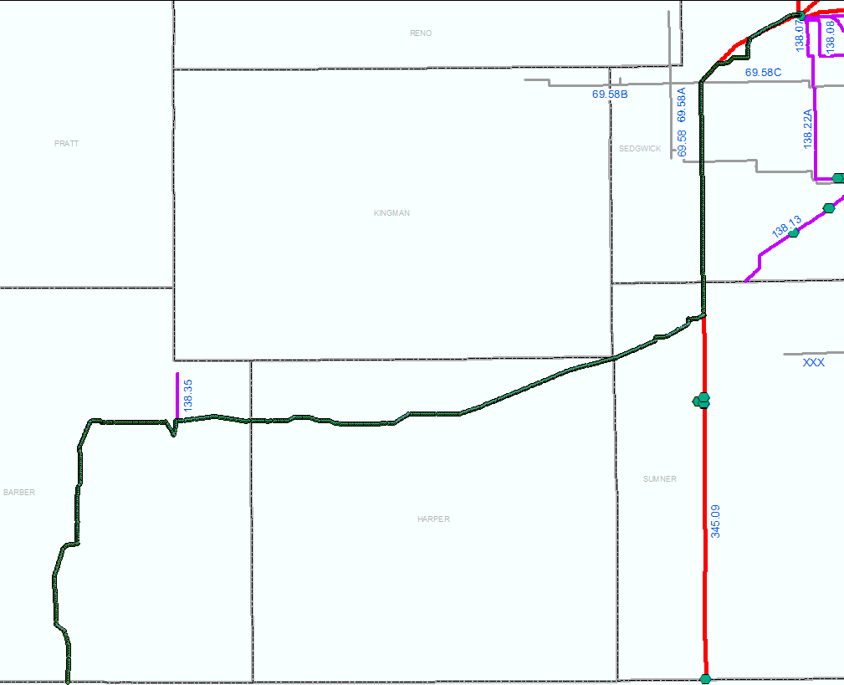
345 kV Project: Wichita-Thistle-Woodward
Prairie Wind Transmission’s Project
Westar’s Wichita Sub to ITC’s Thistle Sub to OGE’s Woodward Sub
In-Service June 2014

Slide 23
Today
Quick Review of the Prairie Wind Transmission (PWT) Formula
The Results: 2014 Actual ATRR vs. Projected 2014 ATRR
Protocol Review

Slide 24
Quick Review: The PWT Transmission Formula (True-Up)
Gross Revenue Requirement (GRR) includes:
Actual Transmission Plant
Actual Transmission O&M
Actual Transmission Depreciation Expense
Taxes
Return
Actual CWIP is included as an adjustment to Rate Base
Net Revenue Requirement adjusts the GRR for:
Revenue Credits received for Point-to-Point Transmission Service
True-up adjustment

Slide 25
A Refresher of the Timing (Example: 2016 Rate Year)
June 2015: True-up Amount from prior Rate Year (2014) is posted
Next Rate Year (2016) includes the 2014 True-up and 2016 Projected ATRR
September 2015: Projected ATRR for the next Rate Year (2016) is posted

Slide 26
The Results: Projected vs Actual ATRR for 2014
 | Projected | Actual
PWT’s Gross Rev. Requirement | $20,412,567 | $21,063,835
Revenue Credits | ($ 1,933,250) | ($ 1,702,325)
True-Up Adjustment | ($ 2,314,426) | ($ 2,314,426)
Prior Period Adjustment | ($ 213,312)
PWT’s Net Rev. Requirement | $15,951,579 | $17,047,084
True-Up Amount* (before interest) |  | $ 1,095,505
* Amount to be applied to 2016 ATRR (plus interest), in the rates effective January 1, 2016

Slide 27
A Review of PWT Formula Protocols
Today: June 23, 2015
Data requests regarding this true-up calculation may be submitted until September 27, 2015
Westar will make its best effort to respond within 15 business days of the receipt of such requests
Send comments or data requests via e-mail to:
Donna Lehman at donna.lehman@westarenergy.com
Please cc: gelene.tiller@westarenergy.com and suzanne.lane@westarenergy.com

Slide 28
Summary
Thank you very much for participating in today’s meeting!
We are here to assist in any way possible.
Please let us know if you have any questions.
Safe travels home!
SAVE THE DATE FOR THE 2016 ANNUAL PRAIRIE WIND ATRR MEETING: September 22, 2015

