Slide 1
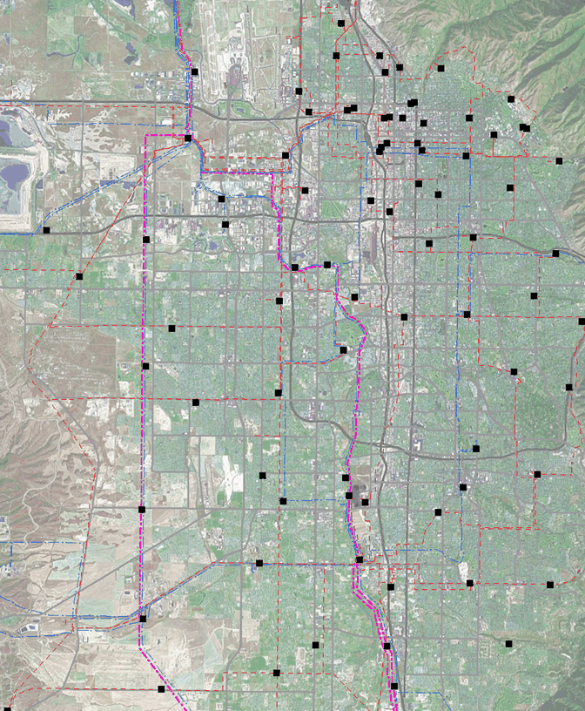
SALT LAKE VALLEY STUDY
Main Transmission Sources
  345-138 kV Transformers. Terminal, Mid Valley, 90th South and Oquirrh
Generation: Gadsby (~350 MW - 6 units); Other area generation contributions of approximately 562 MW.
Total connected is about 915 MW.
Gadsby
Terminal
Midvalley
West Valley Gen
Area | 2012* Load (MW) | 2013* Load (MW) | 2018 Load (MW) | 2018 Growth Rate (%)
Northeast | 590 | 617 | 670 | 1.3
Northwest | 451 | 477 | 500 | .9
Southeast | 648 | 665 | 740 | 1.6
Southwest | 750 | 775 | 841 | 1.5
Total | 2439 | 2534 | 2751 | 1.4%
*Actual loading for 2012 and 2013. 2018 is projected from 2013.
90th South
Oquirrh
Scott Murdock/Jeremy Viula/Stein Sandberg
Notes:
Wasatch Mountain Range to the East; Traverse Mountain Range to the South; Oquirrh Mountain Range to the West; I-80 extending to North Temple to the east
Park City and Tooele are not covered in this study. Also, the area north of I-80 extending to North Temple is covered in the North Salt Lake study.

Slide 2
Load Duration Curve Salt Lake Valley
Transformer Capacity
345-138 kV 4567 MVA (8)
138-46 kV 1918 MVA (13)
Distribution 3300 MVA (136)
2018 projected Summer peak load is 2,751 MW based on a projected growth of 1.4%
The overall load factor is 61%
Notes:
(69) 138-12.5kV transformers totaling 2043.6 MVA; (53) 46-12.47kV transformers totaling 1,073.5 MVA; (6) 46-7.2kV transformers totaling 109 MVA; (8) 46-4.16kV transformers totaling 52.4 MVA

Slide 3
N-0 System Problems & Future Requirements
Recommended Improvement(s)
Increase Capacity at Camp Williams
Remove a 2 MVA 138-12.5 transformer
Replace it with a 30 MVA unit
Benefit: Offloads: Porter Rockwell, South Mountain, Dumas and Bangerter

Slide 4
SALT LAKE VALLEY N-1 ISSUES
Two noteworthy outages:
1) Loss of a 138-46 kV transformer at 90th South.
2) Loss of #5 138-46 kV transformer at McClelland.
Both can be handled with switching contingencies.

