Slide 1
PacifiCorp Annual Transmission Customer Meeting
August 6, 2015

Slide 2
Safety First!
Welcome to PacifiCorp & Rocky Mountain Power!
We are committed to providing a safe and secure working environment at all times.
Security
All visitors must be escorted by a PacifiCorp employee or badged contractor.
Emergency Evacuation
If an emergency alarm or public announcement directs you to evacuate the facility, take direction from your PacifiCorp host [Rick Vail, Portland & Rachel Matheson, SLC] . Building evacuation routes are prominently displayed near all exit doors.
If you are separated from your host, follow the lighted exit signs to the nearest exit.
DO NOT stop to retrieve your personal belongings.
DO NOT re-enter the building until the facility has been cleared for entry.

Slide 3
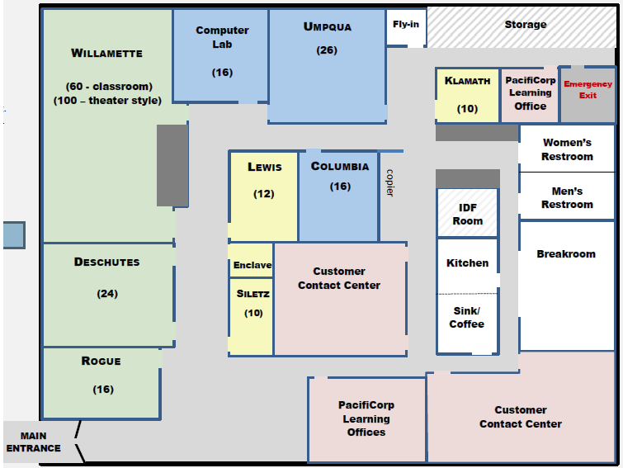
Safety at the Lloyd Learning Center
Exit Here
Exit Here

Slide 4
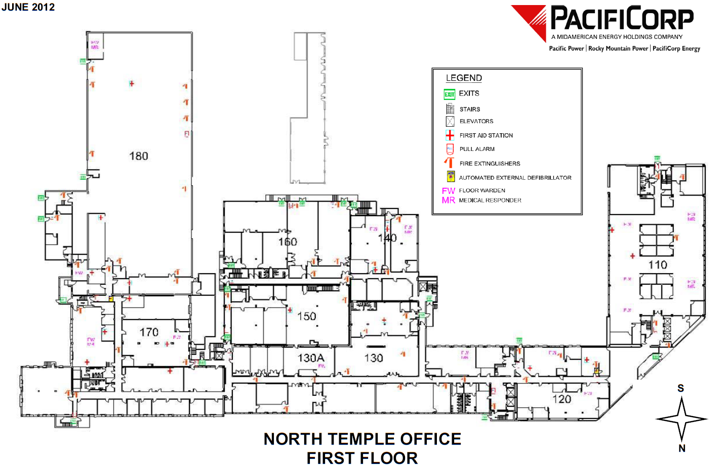
Safety at the North Temple Office
Exit Here
Exit Here

Slide 5
PacifiCorp Transmission
President and CEO
Pat Reiten
Mgr., Exec Support Svcs.
Tonia Stratton
VP, Transmission
Rick Vail
VP, Major Project Delivery
Stuart Kelly
VP & General Counsel Sarah Edmonds
Director Compliance
Colt Norrish
VP, System Operations
Mark Sampson
VP, Division Controller
Todd Dinehart

Slide 6
Transmission
Vice President, Transmission
Rick Vail
Dir., Transmission Planning & Capital Investment
Jack (JD) Podlesnik
Director Transmission Services
Brian Fritz
Manager Contract Admin & Transmission Services
Patience Kerchinsky
Manager Transmission Scheduling Service
Brian McClelland
Director Reliability Standards
Flo Hausler

Slide 7
General Counsel, Transmission Policy & Strategy
Vice President &
General Counsel
Sarah Edmonds
Senior Counsel
Patrick Cannon
Mgr., Regulatory Policy & Rates
Shayleah LaBray
Senior Counsel
Mary Ellen Stefanou
Sr. Planning Financial Analyst
Eric Arzola
Transmission Regulatory Analyst
Lisa Harkins
Sr. Planning Financial Analyst
Natalia Bronner
Legal Assistant
Morgan Herring
Transmission Market Specialist
Christine Kirsten

