Slide 1
TVA RC 2017 Summer Outlook
TVA RC
July 27, 2017

Slide 2
2017 Summer Outlook: Executive Summary
Position, Weather & Load
TVA summer peak forecast for August is 30,101 MW @ 96°, a temperature change of 1° above normal adds 200 – 300 MW
LGE/KU 7193 MW projected peak, August
AECI projected peak 4635 MW, July
Hydro
Near normal rainfall but below normal runoff throughout the summer
Nuclear
WBN 02 FO RTS July
Coal
none
Gas
JOT 01–10 PO (532 MW)
New Facilities
Paradise Combined Cycle (PCC)
3x1 CC plant
Replaces PAF Units 1 and 2 (PAF U3 not affected)
Beginning testing September 2017
Scheduled for commercial operation June 2018

Slide 3
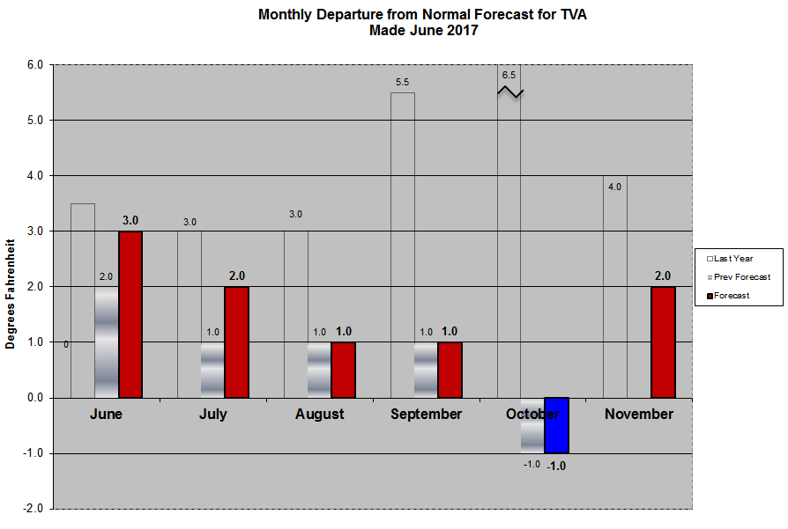
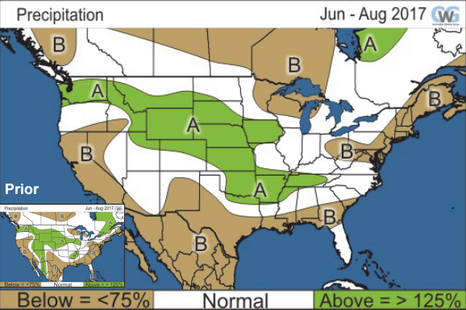
Summer 2017 Temperatures
Expecting a slightly warmer than normal summer
Degrees above normal: June +3, July +2, Aug +1
Precipitation above normal
Hurricane season forecast to be below normal
Forecasted Peak in August 2017 is 30,101 MW at 96°F. Actual peak for 2016 was 29,754 MW at 96°F.
Not expecting prolonged extreme heat this summer
Key analogs: 2013,2015

Slide 4
Operational Planning Summer Studies
Study Scenarios
Peak Case – Forecasted load in SDX
Extreme Peak –Forecasted load scaled up 15%
Low Hydro—Tributary hydro units off, Main river reduced
Shoulder Period—Scaled down 20%, pump Raccoon, Rocky Mtn., Carter’s Dam
Transfer Case—N-S, S-N, W-E transfers applied

Slide 5
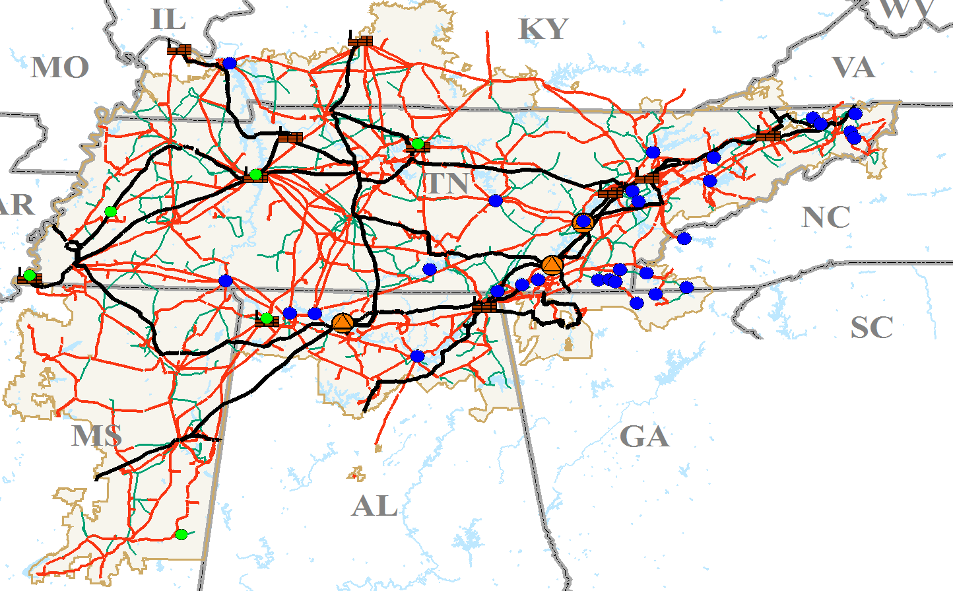
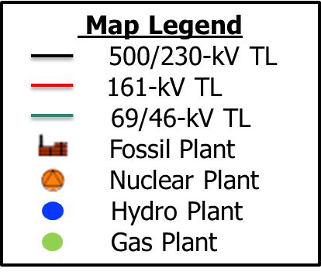
Transmission Constrained Areas for Summer 2017
Johnsonville Switch-house and Transformer replacement
Constraint: Various 161 kV lines terminating at Johnsonville FP
Contingency: Various elements
Shawnee Fossil - Bypass DOE yards
Constraint: various 161 kV lines
Contingency: Various elements
Northeast Area
Constraint: Volunteer-Phipps Bend 500-kV line Phipps Bend 500-kV yard bypassed.
Contingency: Various elements
West Point Switch-house and Transformer replacement
Constraints: Lowndes and Clay transformers, various 161 kV lines
Contingency: Various elements
Raccoon Mountain Pumping:
Constraint:
WCF 500/161 kV bank
Contingency: Various elements
Raccoon Mountain Generating
Constraint: WCF-SQN 500-kV line
Contingency: Various elements

Slide 6
LGE/KU Outages
Clark Co - Fawkes KU 138kV
7/24/17-10/19/17
Currently info only

Slide 7
Solar Eclipse August 21, 2017

Slide 8
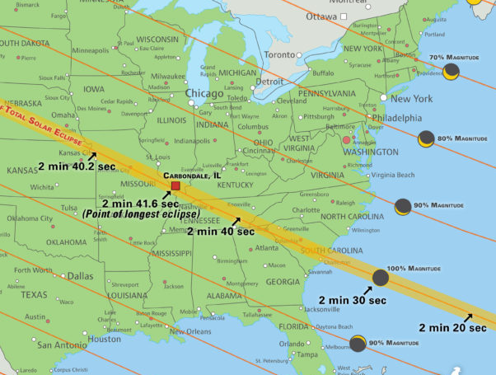
Solar Eclipse - August 21, 2017
90% or greater over coverage all of TVA Service territory
Major load center will be in the dark for 2 mins and 45 sec (Nashville, Clarksville)
Lessons learned from European Eclipse in 2015

Slide 9
Solar Eclipse Effects - August 21, 2017
Expect to lose 90% or more of solar capacity (~400 MW)
Exterior lighting will be a significant load contributor to TVA in Nashville metro area
Even in the 90% area, interior lighting usage will increase
Temporary decrease in temperature should slow demand growth if briefly during afternoon climb.
Expect a significant rebound from lights shutting off and solar capacity return

Slide 10
Solar Eclipse Mitigation - August 21, 2017
Ensure adequate, responsive generating reserves will be available to adjust for any needed system changes
TVA BA is planning to make generation adjustments to offset potential load/generation impacts.
As a Reliability Coordinator, TVA will be working with other Reliability Coordinators (SOCO, PJM, MISO) to ensure adequate generation reserves are available to respond to power system changes during the eclipse.

Slide 11
Additional RC Updates
Completed seven week cycle of RC restoration Drill to meet EOP-006 for member systems within TVA RC footprint in July
TVA RC member company face to face meeting to be held in September in Chattanooga
TVA RC expanded model work progressing to add MISO and SPP full models to state estimator
Expanding the Voltage Stability Monitoring Tool to include RC member companies
Working with Congestion Management entities to update existing freeze date model for NNL allocation

