Slide 1
ATC Training
Duke Energy Carolinas
ATC Calculation Process
December 15th, 2011

Slide 2

Agenda
Objectives
Introduction
Flowgate methodology basics
Data Inputs
AFC Calculation
Posted ATC

Slide 3
Objectives
ATC Training

Slide 4
Objectives
High-level understanding of new Available Transfer Capability (ATC) Process
  Inputs to the ATC process
  How inputs affect the ATC process
  Transfer Distribution Factors (TDFs)
  How ATC is calculated

Slide 5
Introduction
ATC Training

Slide 6
How Did We Get Here?
Change Order signed with OATi
Mar
Discussion on switching to AFC begins
Dec
OATi delivered AFC system to test
Sep
2011
Aug
Decision made to switch to AFC
Tested AFC process
Jan
Implemented AFC process
2007
2008
2009
2010
Evaluation of FERC order 729/676-E impacts
Legislative Timeline
Feb
Nov
Apr
2007
2008
2009
2010
2011
FERC order 890
FERC orders 729/676-E
Effective date of FERC orders 729/676-E
Effective date of NERC MOD Standards

Slide 7
Duke Energy Carolinas ATC Process
Implemented the Flowgate Methodology
  NERC MOD-030 Reliability Standard
Two (2) main components to process
  Model Builder (PowerGEM TARA AMB)
  ATC Calculator (OATi webTrans)
Automated Process
Increased the level of required coordination with other TSPs
  TSRs
  Tags
  Outages
  AFC Values
  Flowgates
  Generation Dispatch Files
  Load Forecasts

Slide 8
Flowgate Methodology Basics
ATC Training

Slide 9
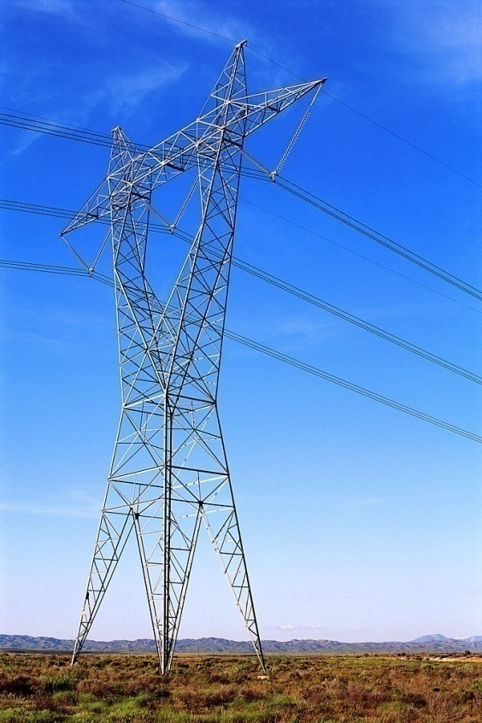
What is a Flowgate?
NERC defines a Flowgate as:
  A mathematical construct, comprised of one or more monitored transmission Facilities and optionally one or more contingency Facilities, used to analyze the impact of power flows upon the Bulk Electric System.
More simply put:
  A Flowgate is a transmission line or transformer that is being monitored for overloads incurred by normal operating conditions or for loss of another transmission line or transformer

Slide 10
Flowgate Identification
Flowgate identification is performed at least annually
  Identifies list of Flowgates internal to Duke Energy Carolinas
  Screens external Flowgates and includes those that meet/exceed criteria
    An external TSP can request Duke Energy Carolinas to incorporate their Flowgates into the Duke Energy Carolinas process
Duke ATC process currently contains 670 Flowgates
  379 internal DUK Flowgates & 291 External Flowgates
Breakout of Flowgates in Duke Process by TSP
DUK | CPL | PJM | SC | SCEG | SOCO | TVA | Total
379 | 56 | 82 | 62 | 50 | 29 | 12 | 670

Slide 11
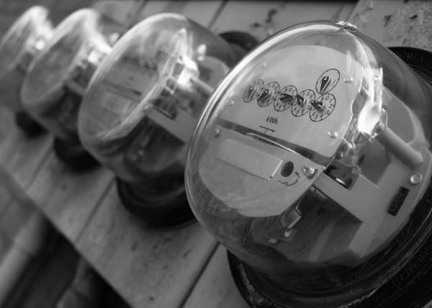
What is AFC?
Available Flowgate Capability
NERC defines AFC as:
  A measure of the flow capability remaining on a Flowgate for further commercial activity over and above already committed uses.
More simply put:
  AFC is the commercial capability remaining on the Flowgate.

Slide 12
Data Inputs
ATC Training

Slide 13
ATC Process Overview
External TSP AFC Overrides
Adjacent TSP Reservations
Duke TSP flowgates
FG Definition File
External TSP flowgates
Model Builder
(PowerGem)
Shift Factors
ATC Calculator
(webTrans)
Seed Case
Outages
Load Forecast
Base Flow
Tags
TFC
Gen Dispatch Files
Duke
Reservations
Adjacent TSP Gen Dispatch Files
Duke webOASIS
ATC

Slide 14
Adjacent TSP TSRs
Process includes TSRs from adjacent TSPs
  Old process only contained DUK TSRs
  Filtered to remove duplicate TSRs
  Must have TDF greater than 5%
Adjacent TSRs provided by adjacent TSP
  Availability/accuracy based on adjacent TSP
ATC Calculator downloads/applies Adjacent TSP TSRs
  OATi webTrans
  Applies Adjacent TSP TSRs at horizon initialization
Coordinating TSPs
  CPL, PJM, SC, SCEG, SOCO, SEHA, SETH, TAP, TVA, YAD

Slide 15
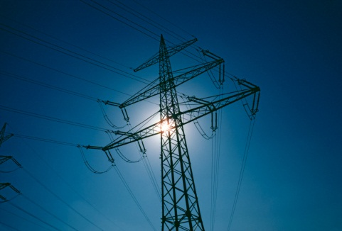
External TSP Flowgates
Duke Energy Carolinas includes Flowgates outside of its system in the ATC process
  Called “External Flowgates”
  Owned by another Transmission Service Provider (TSP)
Flowgates that are not owned by Duke Energy Carolinas
  Includes any Flowgate in the VACAR Reliability Coordinator Area that had a TLR called in past 12 months
    At the time the list of Flowgates was created
  Any TSP can request Duke Energy Carolinas to honor their Flowgates
    Must be included in requesting TSP’s ATC process
    Must already be modeled
    Must pass Flowgate screening test

Slide 16
External TSP AFC Overrides
Duke Process Includes AFC Overrides from adjacent TSPs
  Applied to External Flowgates
  Replaces (overrides) the AFC value calculated by DUK
Provided by coordinating TSP
  Availability/accuracy based on adjacent TSP
    If provided, DUK is REQUIRED to use the AFC value.
    If not provided, DUK utilizes value calculated by DUK process
ATC Calculator downloads/applies External AFC Overrides
  OATi webTrans applies AFC Overrides at horizon initialization
    Horizon definitions are included in the ATCID (link)

Slide 17
Seed Case
Starting point powerflow model
  Inputs of the AFC process (Outages, Load, etc) modify the Seed Case to create a model representative of the calculation period
Based on SERC Near-Term Study Group OASIS Studies
  Model is modified to account for mapping concerns (alignment with NERC IDC, SDX, etc) and handling of base case transfers
    ensure that outages, load forecasts, etc can be mapped correctly
    avoid double counting of TSR or tag impacts in the calculation of AFCs.
  Developed quarterly for next 5 seasons

Slide 18
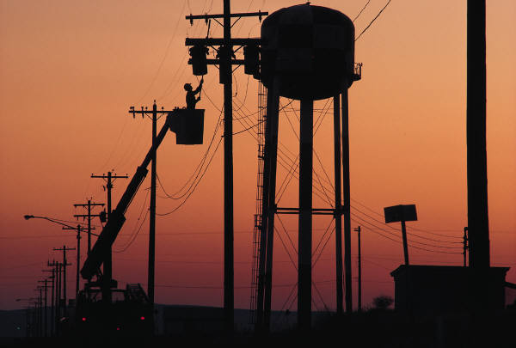
Outages
Download Outages from NERC SDX
  Industry standard database
  Transmission & generation outages
  Utilize outages from:
    Duke Energy Carolinas
    All adjacent TSPs
Outages built into Seed Case
  Refer to the outage criteria in the ATCID (link)
Transmission Outages are viewable on OASIS
  Requires certificate
  Only Duke Energy Carolinas

Slide 19
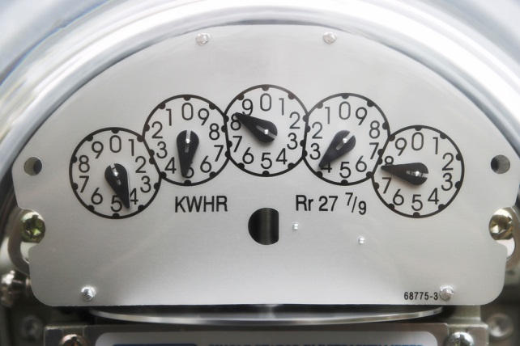
Load Forecasts
Download load data from NERC SDX
  Industry standard database
  Utilize data from:
    Duke Energy Carolinas
    All adjacent TSPs, except PJM
Download load data from PJM
  PJM provides a file that breaks out their load into each legacy BA (increases model accuracy)
Forecasted/Actual Load Data are viewable on OASIS
  Requires certificate
  Only Duke Energy Carolinas
    System load
    Native load

Slide 20

Tags
Download tag data from NERC Tag Dump
  Industry standard database
  Utilize data from:
    Duke Energy Carolinas
    All adjacent TSPs
Modeling of Tags
  Capacity modeled is the Transmission Profile MWs
  Utilize the GCA/LCA to model receipt & delivery points
    Adjusts net area interchange of GCA/LCA
    Tag impacts will be due to physics, not market path
  IPPs internal to DUK utilize the Source & LCA
    Adjusts the output of the specific generator and the net area interchange of GCA/LCA

Slide 21
Tags Continued…
Tags affect the amount of generation dispatched in the Duke Energy Carolina TSP area
  Generation is dispatched to meet load + net area interchange + losses
  Tags sinking in Duke will decrease the generation dispatched
  Tags sourcing from Duke will increase the generation dispatched
Tags will impact the amount of generation dispatched which impacts baseflows of impacted Flowgates
  Based on physics not the market path
  Some Flowgates are more sensitive to generation than others

Slide 22

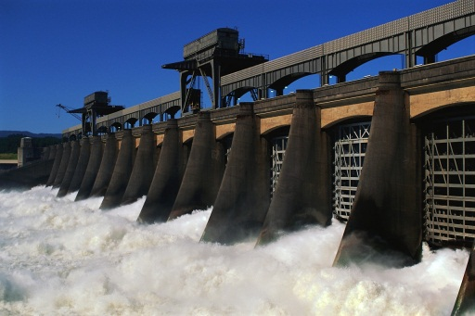
Generation Dispatch Files
Duke Energy Carolinas generation dispatch
  Block Dispatch File
    Groups units into blocks based on dispatch order (typically economics)
  Direct Dispatch Files
    Pumped Storage (based on Duke unit commitment 7-day outlook forecast)
    IPPs – Based on tags in hourly operating horizon
Adjacent TSP generation dispatch
  Block Dispatch File (provided by adjacent TSP)
  Direct Dispatch Files (if provided)

Slide 23
AFC Calculation
ATC Training

Slide 24
ATC Process Overview
External TSP AFC Overrides
Adjacent TSP Reservations
Duke TSP flowgates
FG Definition File
External TSP flowgates
Model Builder
(PowerGem)
Shift Factors
ATC Calculator
(webTrans)
Seed Case
Outages
Load Forecast
Base Flow
Tags
TFC
Gen Dispatch Files
Duke
Reservations
Adjacent TSP Gen Dispatch Files
Duke webOASIS
ATC

Slide 25
Baseflows
Calculated by the Model Builder (PowerGEM TARA AMB)
  MW flow on each flowgate
  Imported to ATC Calculator (OATi webTrans)
  Baseflow values are adjusted to prevent double impacts
    Performed in the ATC Calculator (OATi webTrans)

Slide 26

Shift Factors (GSFs)
Generation Shift Factors (GSFs) measures the sensitivity of a flowgate due to an incremental change in generation dispatch from a subsystem
  Subsystem created for each Control Area (CA) in Eastern Interconnect
    Each company represented by an import & export subsystem
Duke process contains roughly 106 subsystems
  Each subsystem has a factor relating to each Flowgate
    106 subsystems X 670 Flowgates = 71,020 sensitivity factors for each powerflow snapshot
      Hourly48 file contains 71,020 X 48 hours = 3,408,960 sensitivity factors

Slide 27

Transfer Distribution Factors (TDFs)
Portion of a transaction that flows across a Flowgate
  Expressed as a percentage (%)
Based on Generation Shift Factors (GSFs)
  TDF = GSF_{POR} – GSF_{POD}
  Means TDF is dependent on the Source (POR) & Sink (POD) Control Areas (CAs) change in generation dispatch to facilitate the transfer
Used to determine/calculate:
  How much each TSR impacts a Flowgate
  Which Flowgates impact a Path
  The ATC of a Path

Slide 28
How much will my TSR impact a particular Flowgate?
Depends on the TDF
  TSR Flowgate Impact = Granted MW Capacity X TDF
Will need to calculate TSR impact on each impacted Flowgate
Example: TSR = 100 MW
  TDF on Flowgate “A” = -2.32%
    TSR Flowgate Impact (Flowgate A) = 100 X -2.32% = -2.32 MWs
  TDF on Flowgate “B” = 5.01%
    TSR Flowgate Impact (Flowgate B) = 100 X 5.01% = 5.01 MWs

Slide 29
Which Flowgates impact Path “XYZ”?
Depends on the TDF of each Flowgate
  If Flowgate TDF >= to Flowgate threshold, Flowgate is impacted
    3% for Duke Flowgates
    5% for all other Flowgates
Example:
  Using the threshold above, what Flowgates impact DUK-PJM?
    TDF on Flowgate “A” = -.0232 (-2.32%) owned by DUK
      Does not impact DUK-PJM, Flowgate TDF < Flowgate threshold (3%)
    TDF on Flowgate “B” = .0501 (5.01%) owned by TVA
      Impacts DUK-PJM, Flowgate TDF (5.01%) > Flowgate threshold (5%)
Remember TDFs are based on Shift Factors (GSFs)
  Means TDF is dependent on how the Source (POR) & Sink (POD) CAs respond to a Flowgate

Slide 30
Example - Why is there ATC on CPLE-PJM but not DUK-PJM?
Completely different and independent Paths
Because the two Paths are different, Flowgates impact the Paths differently
  TDFs are based on Shift Factors (GSFs)
  Means TDF for each Flowgate is dependent POR & POD
    Path DUK-PJM has POR = DUK & POD = PJM
    Path CPLE-PJM has a POR = CPLE & POD = PJM
  Paths are not the same
    Because POR & POD are not the same

Slide 31
Example - Why is there ATC on CPLE-PJM but not DUK-PJM?
DUK-PJM
CPLE-PJM
PJM generation is scaled down for import
PJM generation is scaled down for import
PJM
Gen scaled
down
PJM
Gen scaled
down
DUK
No changes
The Difference Is
DUK generation does not change
DUK
Gen scaled
up
Flowgates can be more sensitive to gen dispatch in one area vs another area
CPLE
Gen scaled
up
DUK generation is scaled up for export
CPL generation is scaled up for export

Slide 32
Process Timing &Calculation of Posted ATC
ATC Training

Slide 33
ATC Process Overview
External TSP AFC Overrides
Adjacent TSP Reservations
Duke TSP flowgates
FG Definition File
External TSP flowgates
Model Builder
(PowerGem)
Shift Factors
ATC Calculator
(webTrans)
Seed Case
Outages
Load Forecast
Base Flow
Tags
TFC
Gen Dispatch Files
Duke
Reservations
Adjacent TSP Gen Dispatch Files
Duke webOASIS
ATC

Slide 34

ATC Process Timing Schedule
Calculation of ATC values
  ATC adjusted automatically as TSRs change status
    Uses existing model output (baseflows, sensitivity factors, etc.)
  ATC recalculated automatically as Model Builder data imported
  ATC recalculated at horizon initialization
ATC Calculator Inputs
  OATi monitors coordinating TSPs for data downloads
    TSRs
    AFCs
  Model Builder data
    OATi monitors FTP site every 15 mins for data

Slide 35
ATC Process Timing Schedule Continued…
Model Builder Data
  Script runs hourly to download the following inputs:
    Load forecasts, Outages, Tags
  Model creation schedule:
  Model Builder data sent to FTP site for ATC Calculator
Model Series | Frequency
Hourly Non-Firm (near-term) | Every hour (5 mins after hour)
Hourly Firm (near-term) | Every hour (5 mins before hour)
Hourly (long-term) | 7:30, 12:30, 15:30, 23:30
Daily | 7:15, 14:30, 22:30
Monthly | 9:30, 13:30, 21:30
Only required to be updated once/day
Only required to be updated once/month

Slide 36
Posted ATC
How is ATC calculated?
  It is the minimum of the equivalent ATC from the AFC methodology and the Remaining Contract Path Capability (RCPC)
    Ensures Flowgates are respected as well as the contract path interface limits
ATC calculated by “ATC Calculator”
  OATi webTrans software used as “ATC Calculator”
  Exports ATCs to OASIS System Data & Offerings

Slide 37
Posted ATC Continued…
Converting AFCs to an ATC equivalent
  Driven by AFC value and TDF of each flowgate relative to path
  Calculated by following the two steps below:
    Divide every “impacted” Flowgate AFC by it’s associated path TDF
      “Impacted” Flowgates are those who’s TDFs are >= to the threshold (3% for internal Flowgates or 5% for external Flowgates)
    The equivalent ATC is the minimum value from the above calculations
Remaining Contract Path Capability (RCPC)
  Similar to old Area Interchange Methodology (aka Contract Path)

Slide 38
Wrap up
Change to AFC Methodology driven by new NERC MOD Standards
  NERC significantly changed the standard related to our old Area Interchange Methodology (aka Contract Path Methodology)
Process frequency significantly increased
  Automated process to run more frequently than our previous Area Interchange Methodology. To meet/excede requirements.
This process is much more dependent on data
  Most inputs are dynamic and can change throughout the day
  Utilizes significantly more data from other companies
The points mentioned above cause a dynamic calculation
  ATC values will change as data inputs change
  Values should be better aligned with actual system conditions

Slide 39
For More Information…
  ATCID – Posted on OASIS (link)
Attachment C of the OATT – posted on OASIS (link)
ATC Methodology Contact
  dukencieatc@misoenergy.org
  (651) 632-8708
Is there a need for additional ATC/AFC training?
  Was this presentation helpful?

Slide 40
Questions?
E-mail: dukencieatc@misoenergy.org
Phone: (651) 632‐8708

Slide 41
Appendix
ATC Training

Slide 42
ATC Process Overview
External TSP AFC Overrides
Adjacent TSP Reservations
Duke TSP flowgates
FG Definition File
External TSP flowgates
Model Builder
(PowerGem)
Shift Factors
ATC Calculator
(webTrans)
Seed Case
Outages
Load Forecast
Base Flow
Tags
TFC
Gen Dispatch Files
Duke
Reservations
Adjacent TSP Gen Dispatch Files
Duke webOASIS
ATC

Slide 43
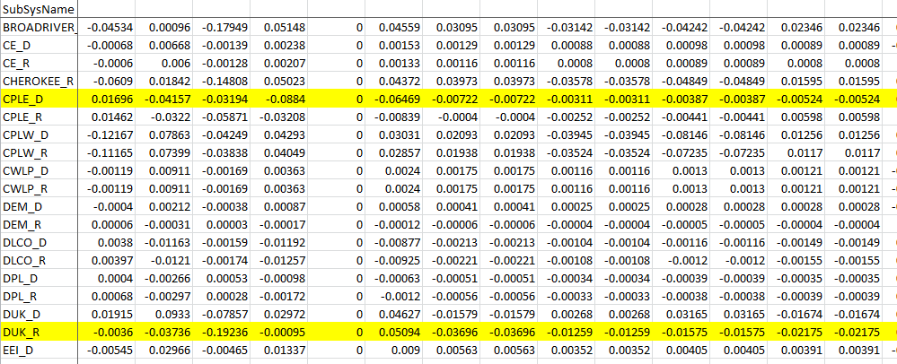
Transfer Distribution Factors (TDFs) Continued…
How do you calculate a TDF for a particular Flowgate?
  Example: What is the TDF of Flowgate A with respect to the DUK-CPLE Path
    TDF = GSF_{POR} – GSF_{POD}
    From table below: GSF_{POR} = DUK_R = -.0036
    GSF_{POD} = CPLE_D = .01696
    TDF = -.0036 - .0196 = -.0232 = -2.32%

Slide 44
Converting AFCs to an ATC equivalent
ATC_{AFC} = min(P)
P ={PATC₁, PATC₂,…PATC_{n}}
PATC_{n} = AFC_{n} / DF_{np}
Where:
ATC_{AFC} = ATC of a Path p based on AFCs
P = set of partial ATCs for all “impacted” Flowgates of Path p
PATC_{n} = partial ATCs for a Path relative to a Flowgate n
AFC_{n} = AFC of Flowgate n
DF_{np} = Distribution Factor of Flowgate n relative to the Path p

Slide 45
Remaining Contract Path Calculation
Remaining Contract Path Capability (RCPC)
  Represents the remaining capacity of Contract Path
  Similar to old Area Interchange Methodology (aka Contract Path)
Firm Equation – All Horizons
  RCPC = CP Limit – TRM – CBM - Conf Firm TSRs
Non-Firm Equation – Prior to 08:00 day prior
  RCPC = CP Limit – TRM – CBM – Conf Firm TSRs – Conf Non-Firm TSRs
Non-Firm Equation – After 08:00 day prior
  RCPC = CP Limit – TRM – CBM – Sch Firm – Conf Non-Firm TSRs

